Slide 1
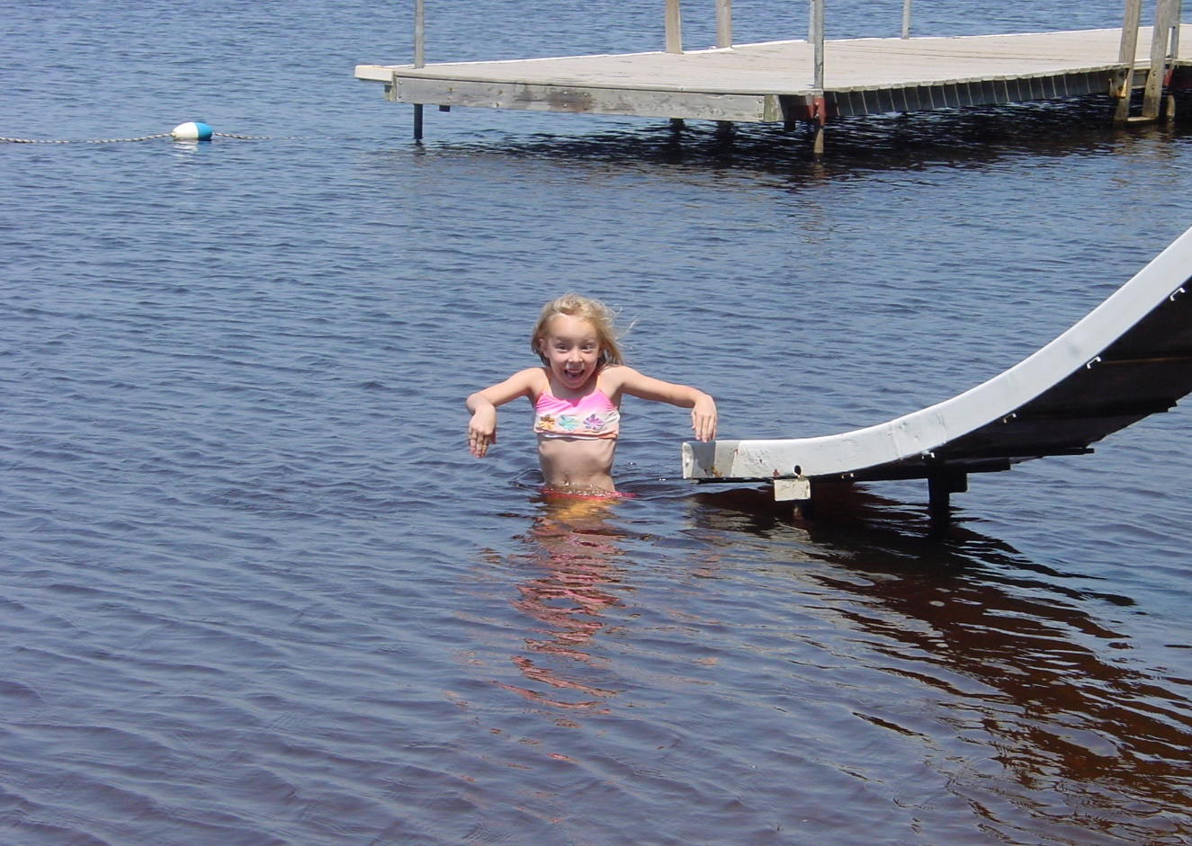
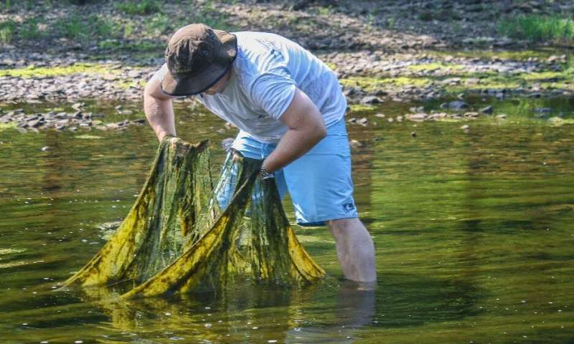
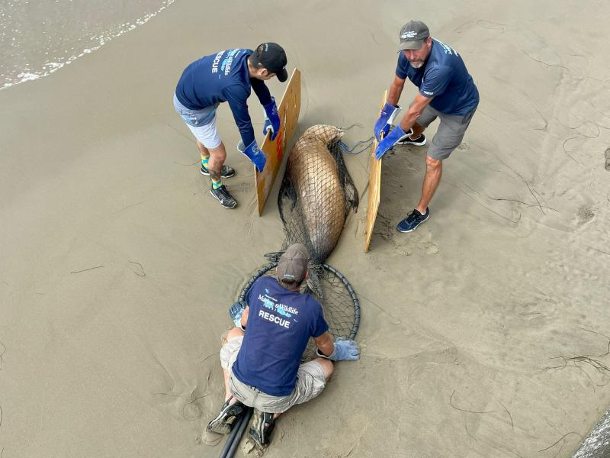
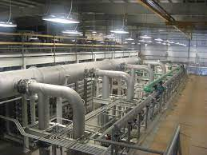
Social Costs of Water Pollution
David Keiser, University of Massachusetts Tina Andarge, University of Massachusetts Mainul Hoque, Cornell University
Yongjie Ji, Iowa State University
Catherine Kling, Cornell University
Daniel Phaneuf, University of Wisconsin
Nilesh Shinde, University of Massachusetts
Yau-Huo Shr, National Taiwan University
We thank the U.S. Department of Agriculture, National Institute of Food and Agriculture, Agriculture and Food Research Initiative (grant numbers 2022-67023-36377 and 2019-67023-29637), the U.S. Environmental Protection Agency's Science to Achieve Program (grant numbers R84065 and R836166), Iowa DNR, National Institutes of Health (grant number R01AG079914A), the Center for Agricultural and Rural Development at Iowa State, and the Cornell Atkinson Center for funding. The content is solely the responsibility of the authors and does not necessarily represent the official views of the National Institutes of Health. Further, the findings and conclusions in this article have not been formally disseminated by the U. S. Department of Agriculture and should not be construed to represent any agency determination or policy.
March 2025

Slide 2
Outline
Overview of Water quality in the US and Clean Water Act
Aside: What do we mean by the Economic Value of the Environment?
Overview of an Integrated Assessment Model of Surface Water Pollution across the United States
Results showing monetized damages across the US from Nutrient Pollution

Slide 3
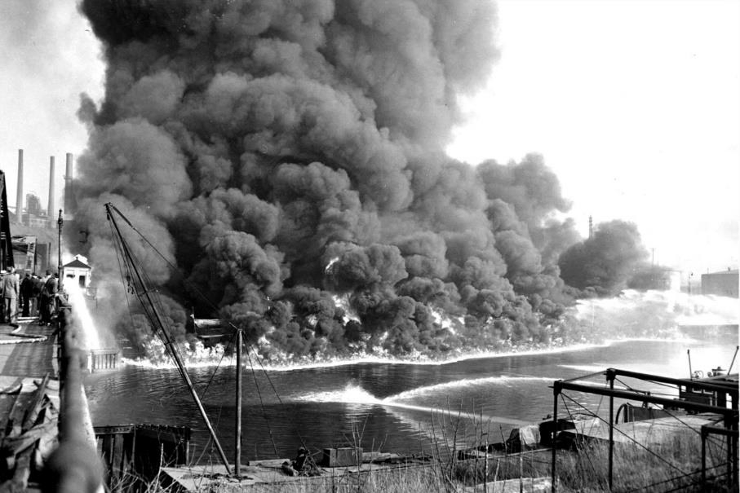
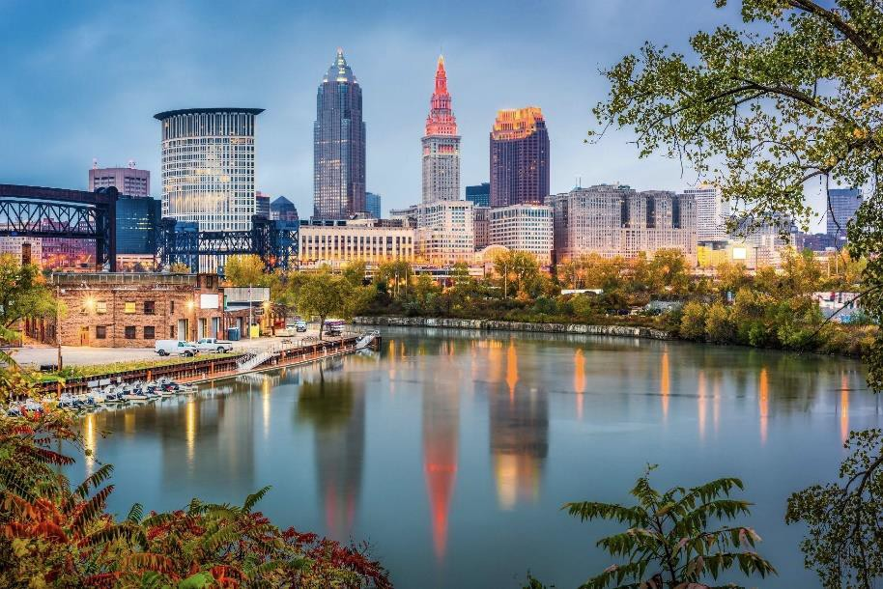
Clean Water Act (1972)
Restore and maintain the chemical, physical and biological integrity of the Nation’s waters
Eliminate discharges into waterways by 1985
Protective of fish, wildlife, recreation by 1983
Cuyahoga River, Cleveland 1952 and current

Slide 4
I. Clean Water Act: Regulations
Clean Water Act (1972) regulates point sources that flow into the waters of the United States
National Pollutant Discharge Elimination System (NPDES) combined with technology standards
Clean Water Act EXEMPTS all cropland, covers large feeding operations
Safe Drinking Water Act requires drinking water standards be met from all public drinking water systems.

Slide 5
Improvements in Water Quality
🏭 Industrial Pollution Reduction: 60% decrease in industrial pollutants released into water bodies. Source: EPA, 2022
🚰 Untreated Sewage Reduction: 98% reduction in untreated sewage discharge due to improved wastewater treatment. Source: EPA, 2021
🐟 Fish and Wildlife Recovery: Significant improvements in some biodiversity, including the return of fish species to previously polluted rivers like the Hudson and Ohio Rivers. Source: USGS, 2022

Slide 6
National Lakes Assessment 2022
Nutrient pollution was the most widespread stressor measured.
High levels of algae and cyanobacteria growth were observed.
Hypereutrophic conditions were observed in 30% of lakes.
Chlorophyll a was in excess and rated poor in 49% of lakes.
3. Poor biological condition was more likely when lakes were in poor condition with respect to nutrients.
In lakes where phosphorus was elevated, benthic macroinvertebrate communities were 1.7 times more likely to be in poor condition.
Based on benthic macroinvertebrates, the EPA found that 29% of lakes were in poor condition and 26% of lakes were in fair condition.

Slide 7
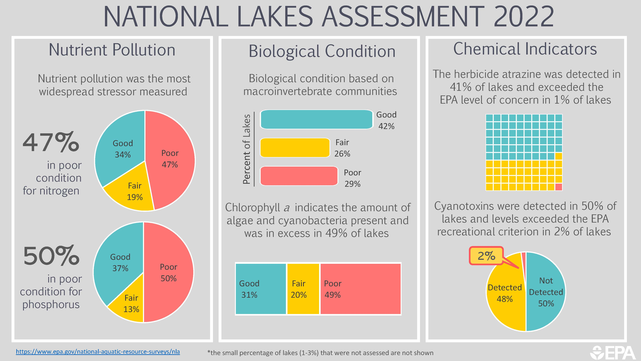

Slide 8
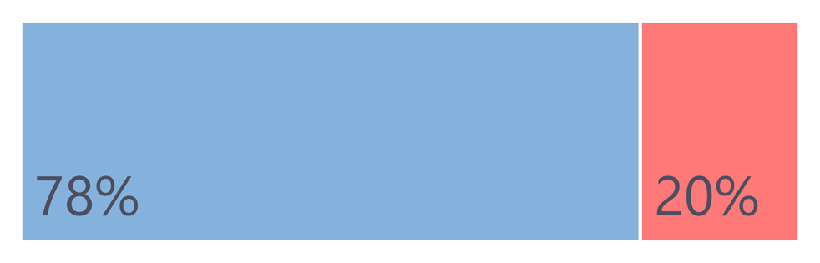






2018-19 RIVERS & STREAMS ASSESSMENT
Nutrient Pollution Biological Condition Habitat & Human Health
44%
Elevated Nitrogen
Good
28%
25%
47%
32%
Fair
44%
Poor
24%
Below Above
Bacteria levels exceeded the EPA human health benchmark in 20% of river and stream miles*
Less than one third (28%) were in good condition based on macroinvertebrate communities
42%
Elevated Phosphorus
Good
42%
36%
Fair
56%
23%
Poor
NA
5%=
Just over one-third (35%) of river and stream miles had healthy fish communities
Stream bank vegetation was rated good in 56% of river and stream miles
Nutrient pollution was the most widespread stressor measured
https://www.epa.gov/national-aquatic-resource-surveys/nrsa
*2% Not Assessed

Slide 9
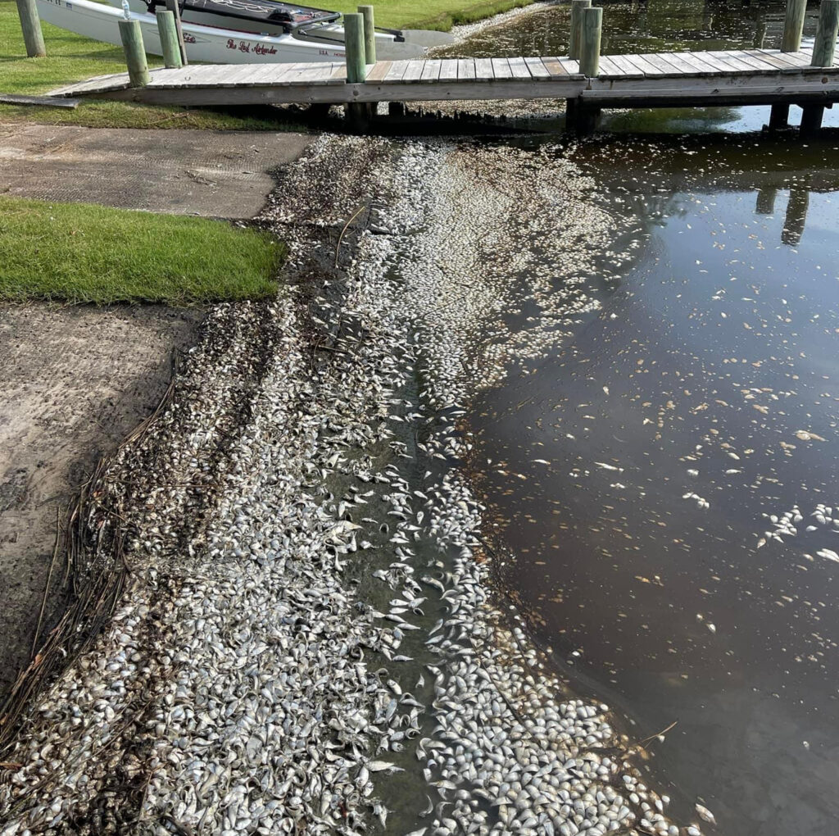
Neuse River Fish Kills
Numerous reports of fish kills on the lower Neuse over the past week are being attributed to abnormally hot water temperatures and nutrient pollution.

Slide 10
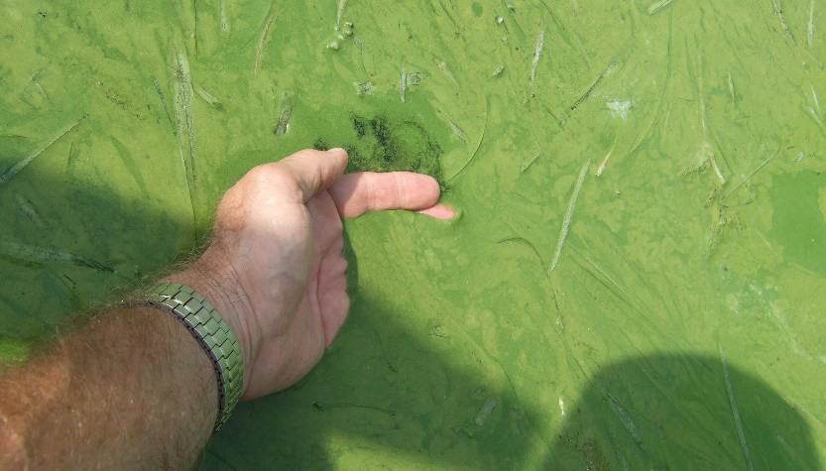
Harmful Algal Blooms (HABs)
(HABS) contain poisonous toxins
“Effects of algal exposure …. range from neurological impairment, to gastrointestinal, respiratory distress, or eye irritation.”
"Potent HAB toxins can kill or sicken fish, shellfish, marine mammals,
birds, wildlife, livestock, and pets.”
78% of coastal waters have excess algae
https://sciencecouncil.noaa.gov/wp-content/uploads/2022/07/1.1-FINAL-SoS_Fact_Sheet_HAB-2.pdf

Slide 11
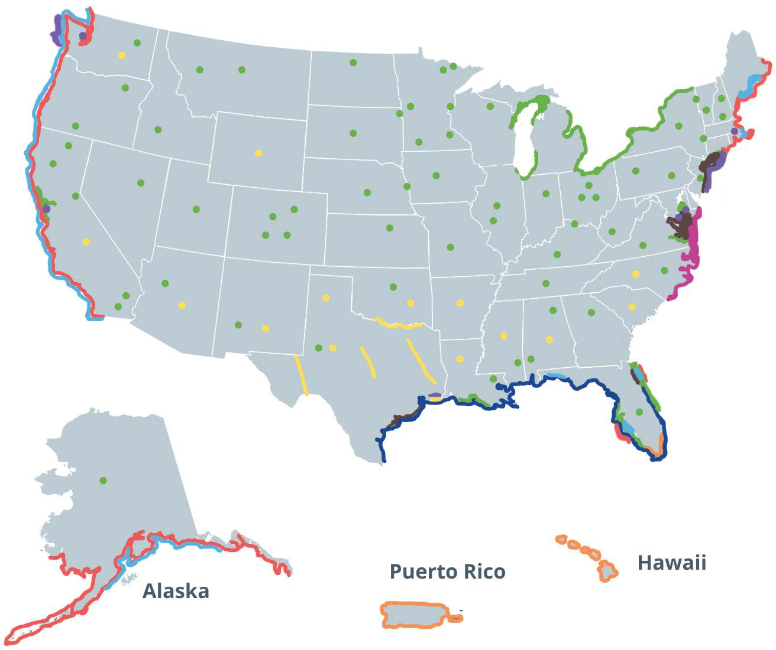
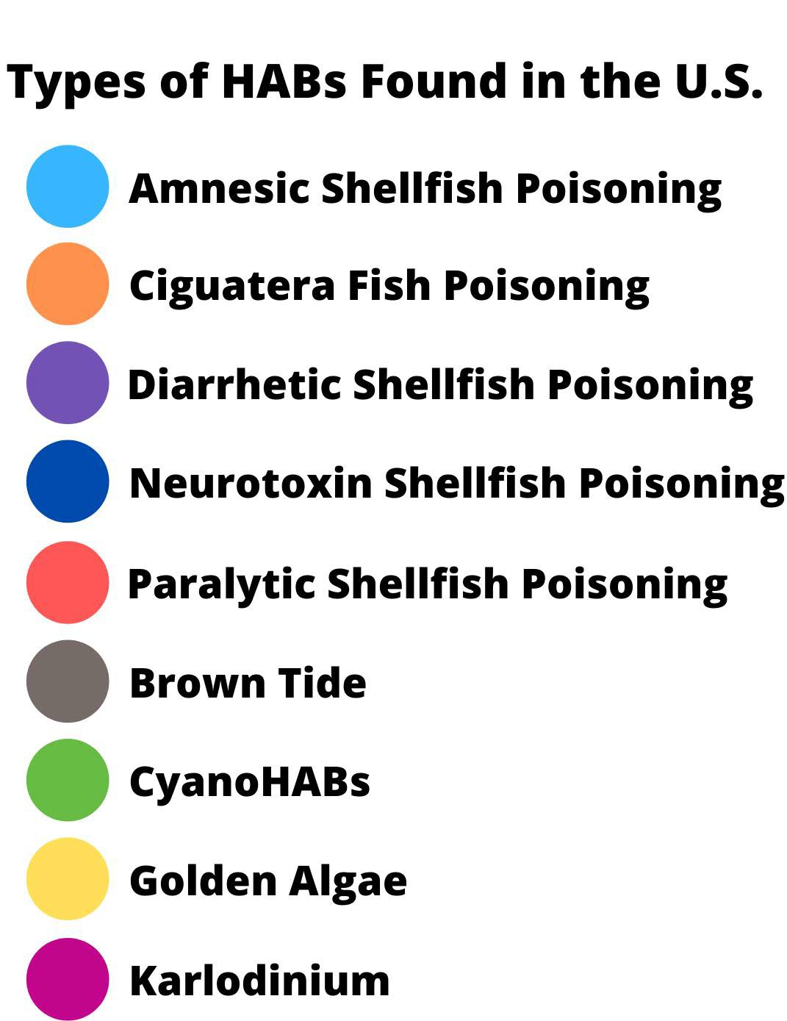
Harmful Algal Blooms
HABs have been reported in every U.S. state and their occurrence is on the rise. This map shows the types of HABs found in the U.S. and where they occur. Credit: NOAA

Slide 12
The primary sources of nutrient pollution are:
Agriculture: The nitrogen and phosphorus in animal manure and chemical fertilizers are necessary to grow crops.
Stormwater: When precipitation falls on our cities and towns it runs across hard surfaces into local waterways.
Wastewater: sewer and septic not always operate properly or remove enough nitrogen and phosphorus before discharging into waterways.
Fossil Fuels: Air deposition of nitrogen
In and Around the Home: Fertilizers, yard and pet waste and certain soaps and detergents

Slide 13
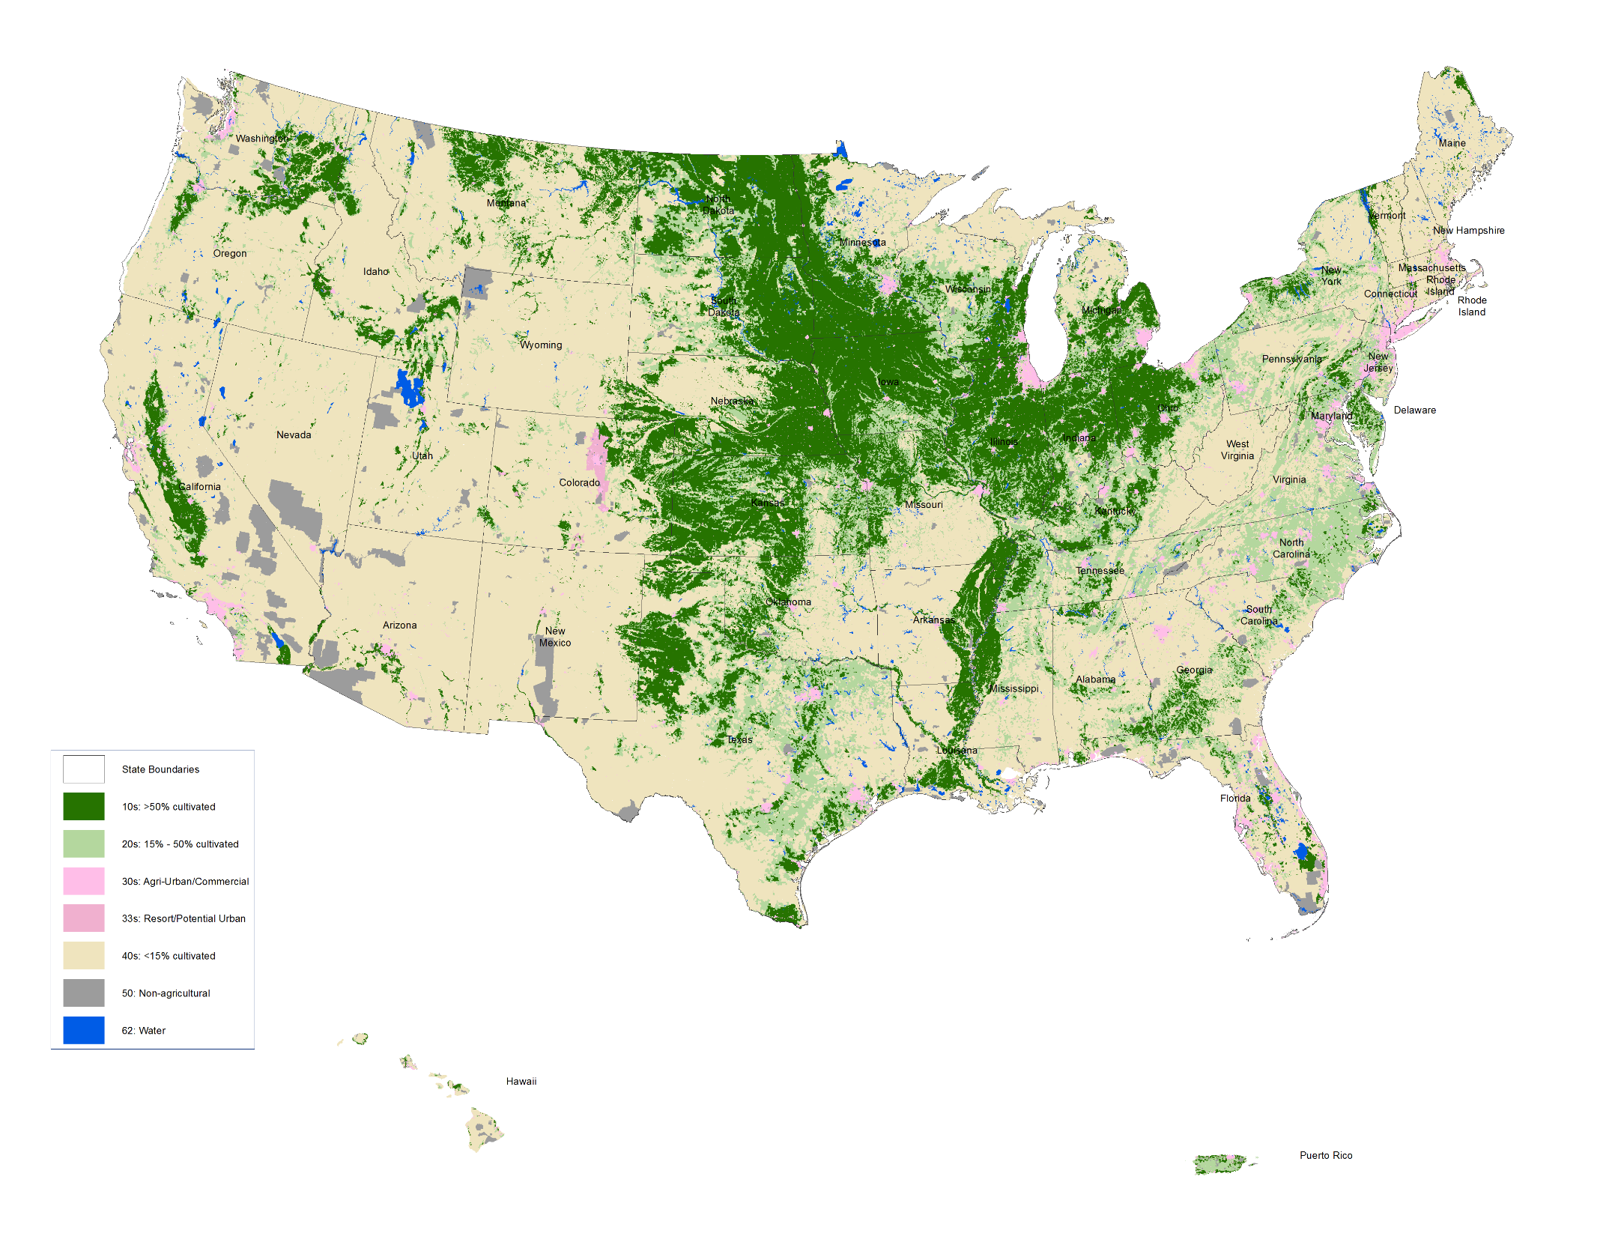
Scale of the Agricultural Footprint
900,000,000 acres of farmland (44% of total)
~1 million farms*
-2017 Ag Census
*over $10K in sale
Notes:
https://www.nass.usda.gov/Publications/Todays_Reports/reports/fnlo0222.pdf
USDA National Agricultural Statistics https://www.nass.usda.gov/Publications/AgCensus/2017/Full_Report/Volume_1,_Chapter_1_US/usv1.pdf

Slide 14
Economic value
Hiking in a neighborhood park, fishing off a bridge on a public lake, watching birds in my backyard, all free…. So no economic value right……?
Economic Value, how much of other goods and services you’re willing to give up to something
Getting something of value for FREE is super valuable!
But why do we need to measure that value?

Slide 15
Why it Matters
Better Measures of our Quality of Life
Important information for Government spending decision of taxpayer money
Reagan Executive Order #12866, signed 1986, requires cost-benefit analysis for all federal regulations with impact > $100million

Slide 16
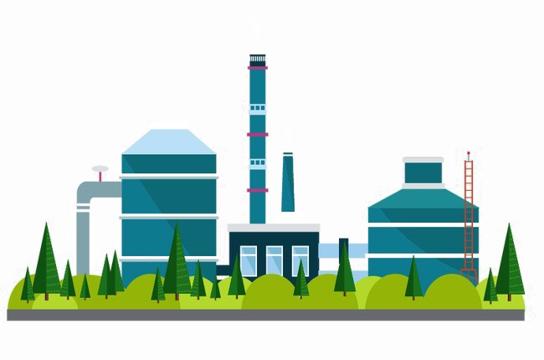
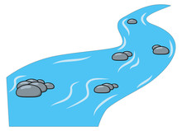




II. IAM for Water Pollution
Build model of nutrient water pollution and fate and transport 2270 watersheds)
Connect the biophysical model to people (Census tracts)
Estimate economic damages from pollution
Recreation, amenity, GHG emissions and, drinking water.
Compute estimates of marginal damages attributable to each watershed in the US based on local and downstream damages its pollution causes
Identify contribution of industry contributions

Slide 17
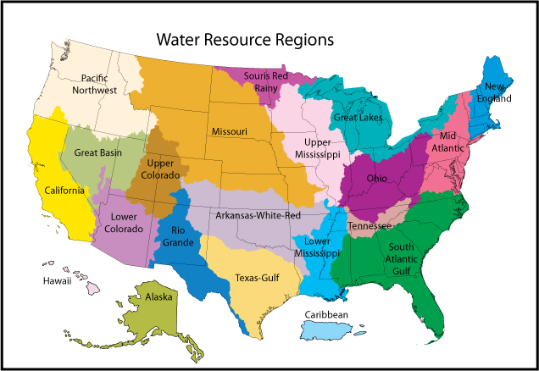
Waterbodies and Hydrography
National Hydrology Dataset (NHD)
- 3 million digitized reaches
  -17,000 Lakes/Reservoirs
18 Major Watersheds
~175,000 sq miles (average)
2270 Smaller, Nested Watersheds
Source: USGS

Slide 18
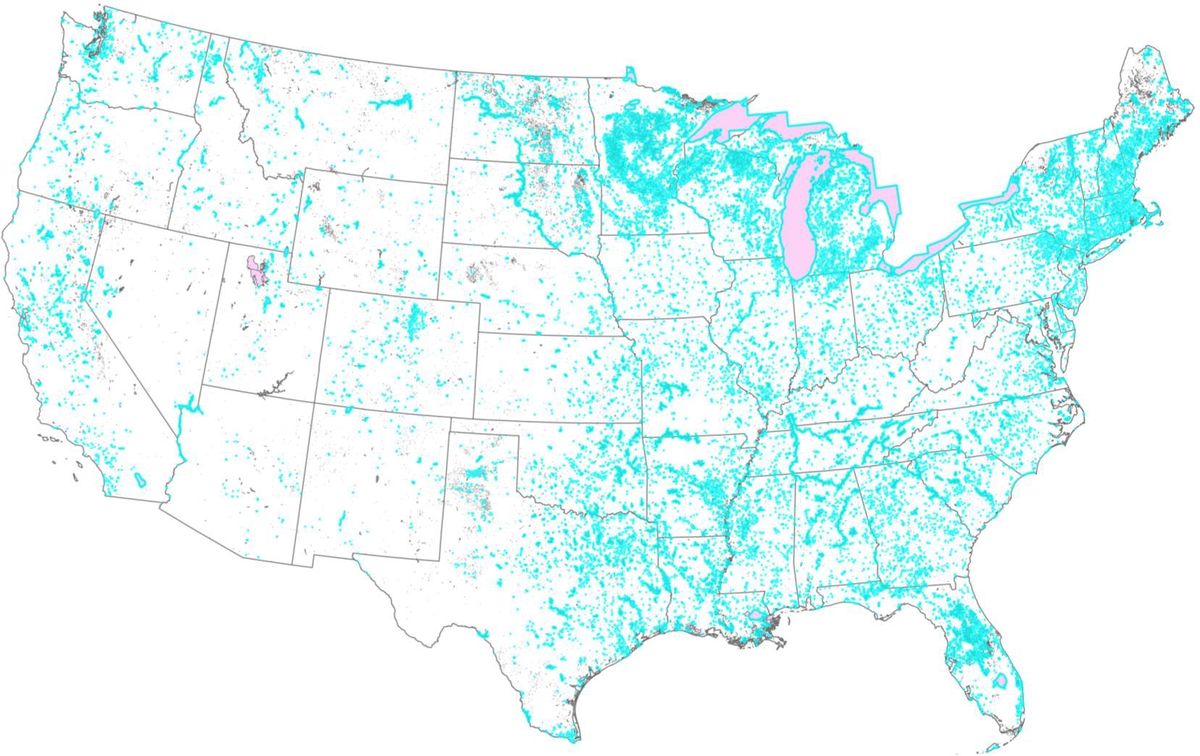
Lakes
~64,000 lakes > 0.1km² (~25 acres) in lower 48 (excluding Great Lakes and Salt Lake) from National Hydrography Dataset (NHD)

Slide 19
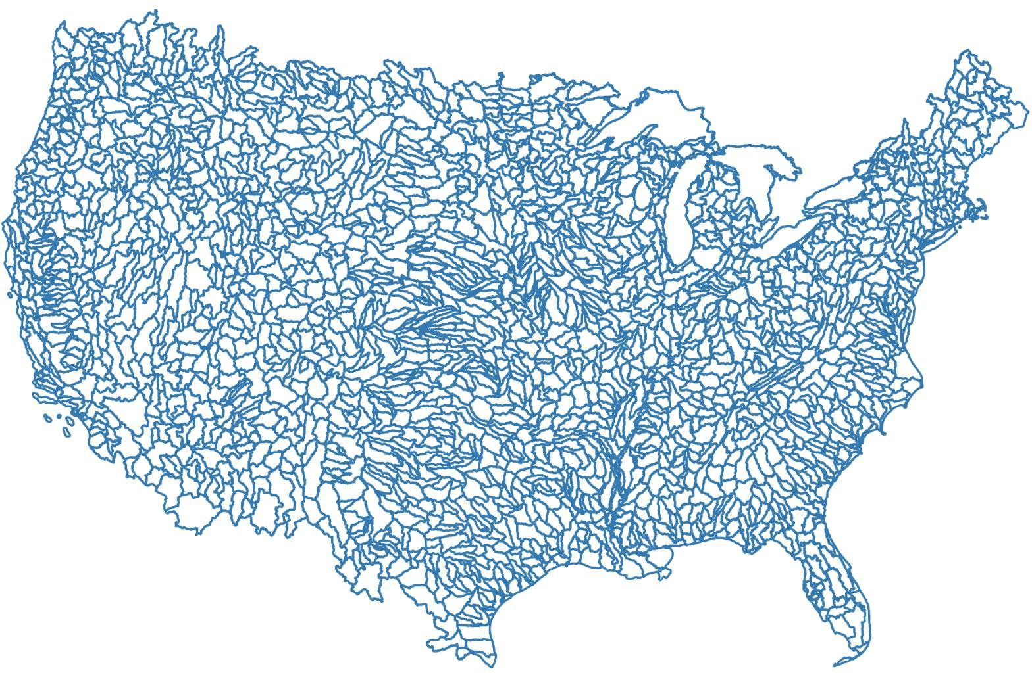
HUC8 Watersheds
2200+ 8-digit hydrological unit code (HUC) watersheds with directional flow connections. Measure ck in watershed k

Slide 20
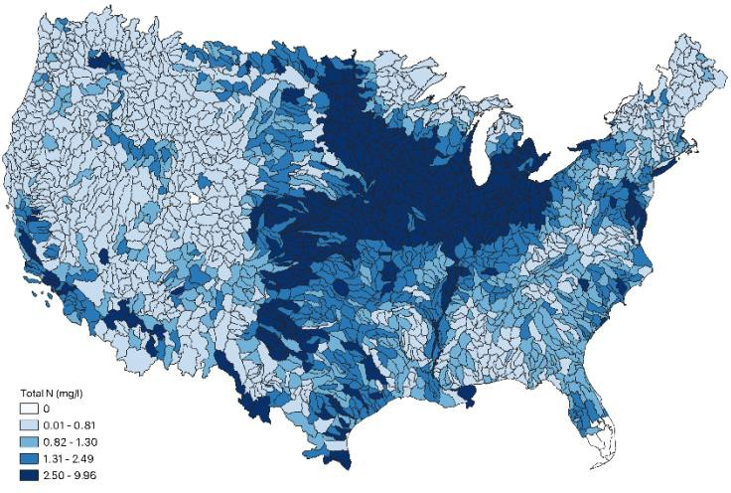
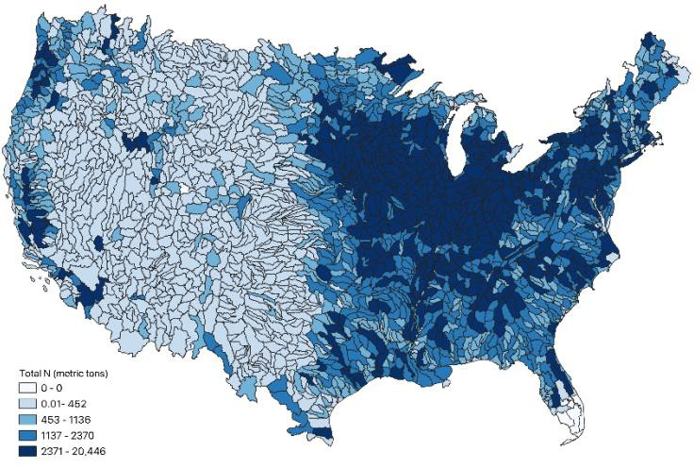
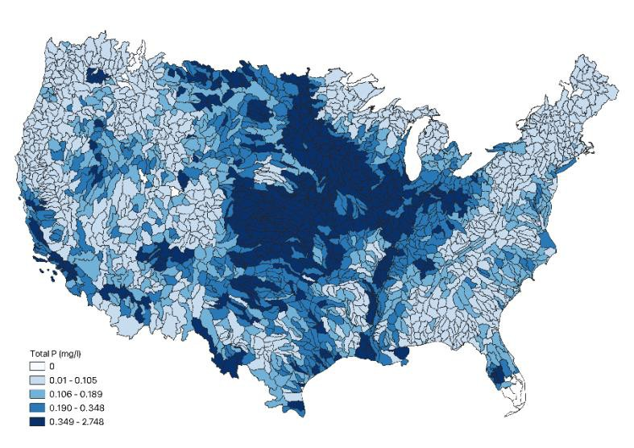
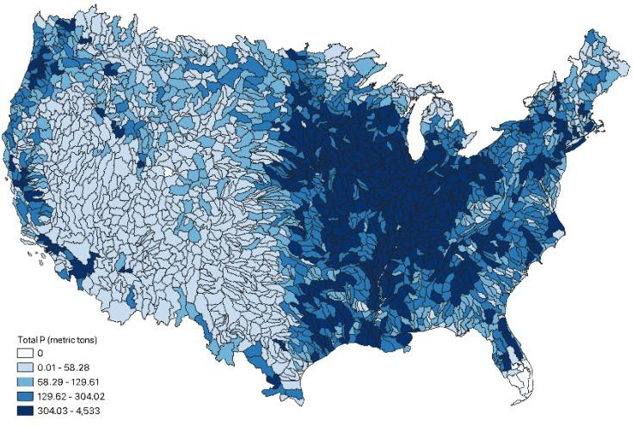
Nutrient Loads and Concentrations
TN concentration (mg/l)
TN load (metric ton/yr)
TP concentration (mg/l)
TP load (metric ton/yr)

Slide 21
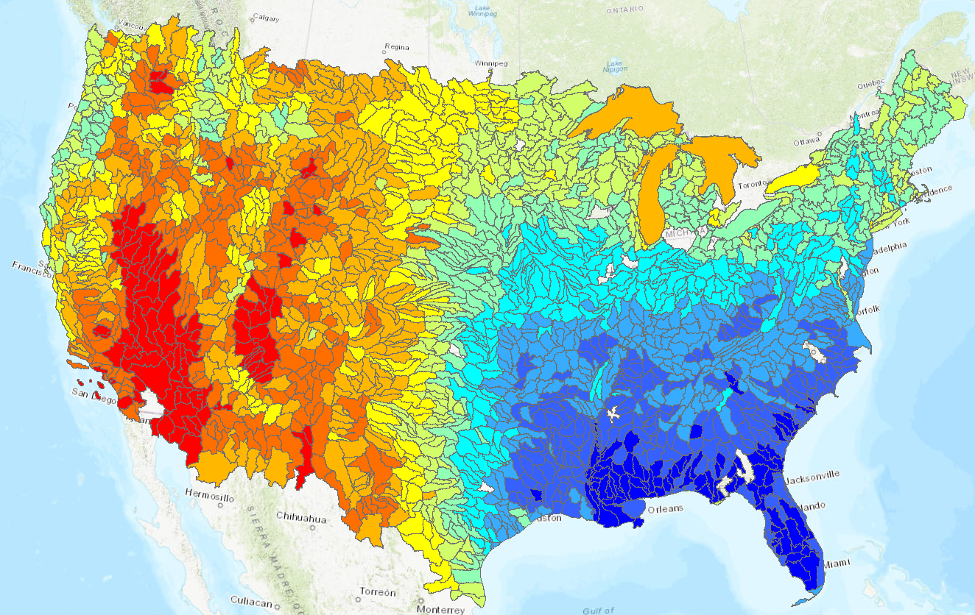
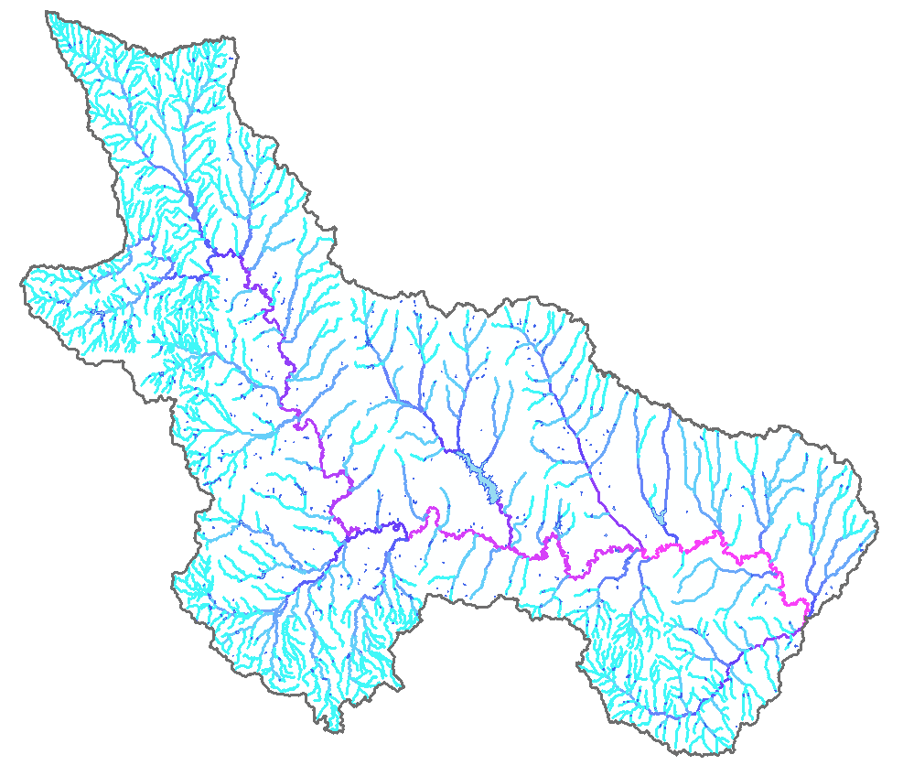
Fate and Transport
We use USGS SPARROW model for (a) moving pollution through hydrological system and (b) assigning loads-by-source in watersheds
2,210 Channels
282
Connected Impoundments
1 of 2,120 HUC 8
Example River Network
Sub-basin map
National Hydrology Data

Slide 22
SPARROW
SPAtially Referenced Regressions On Watershed attributes (Smith et al. 1997):
a hybrid model combining (a) biophysical model of pollution routing/decay + (b) statistical model to estimate lump sum parameters
predicts long run average concentrations/loadings/yields for TN/TP
Our use:
estimates of concentrations and baseline loadings by source for each watershed
pull out decay coefficients to quantify
_{Δc =} ∂c_{j} (E₁,..., E_{J} ) _{ΔE}
j
k
∀j
∂E
k

Slide 23
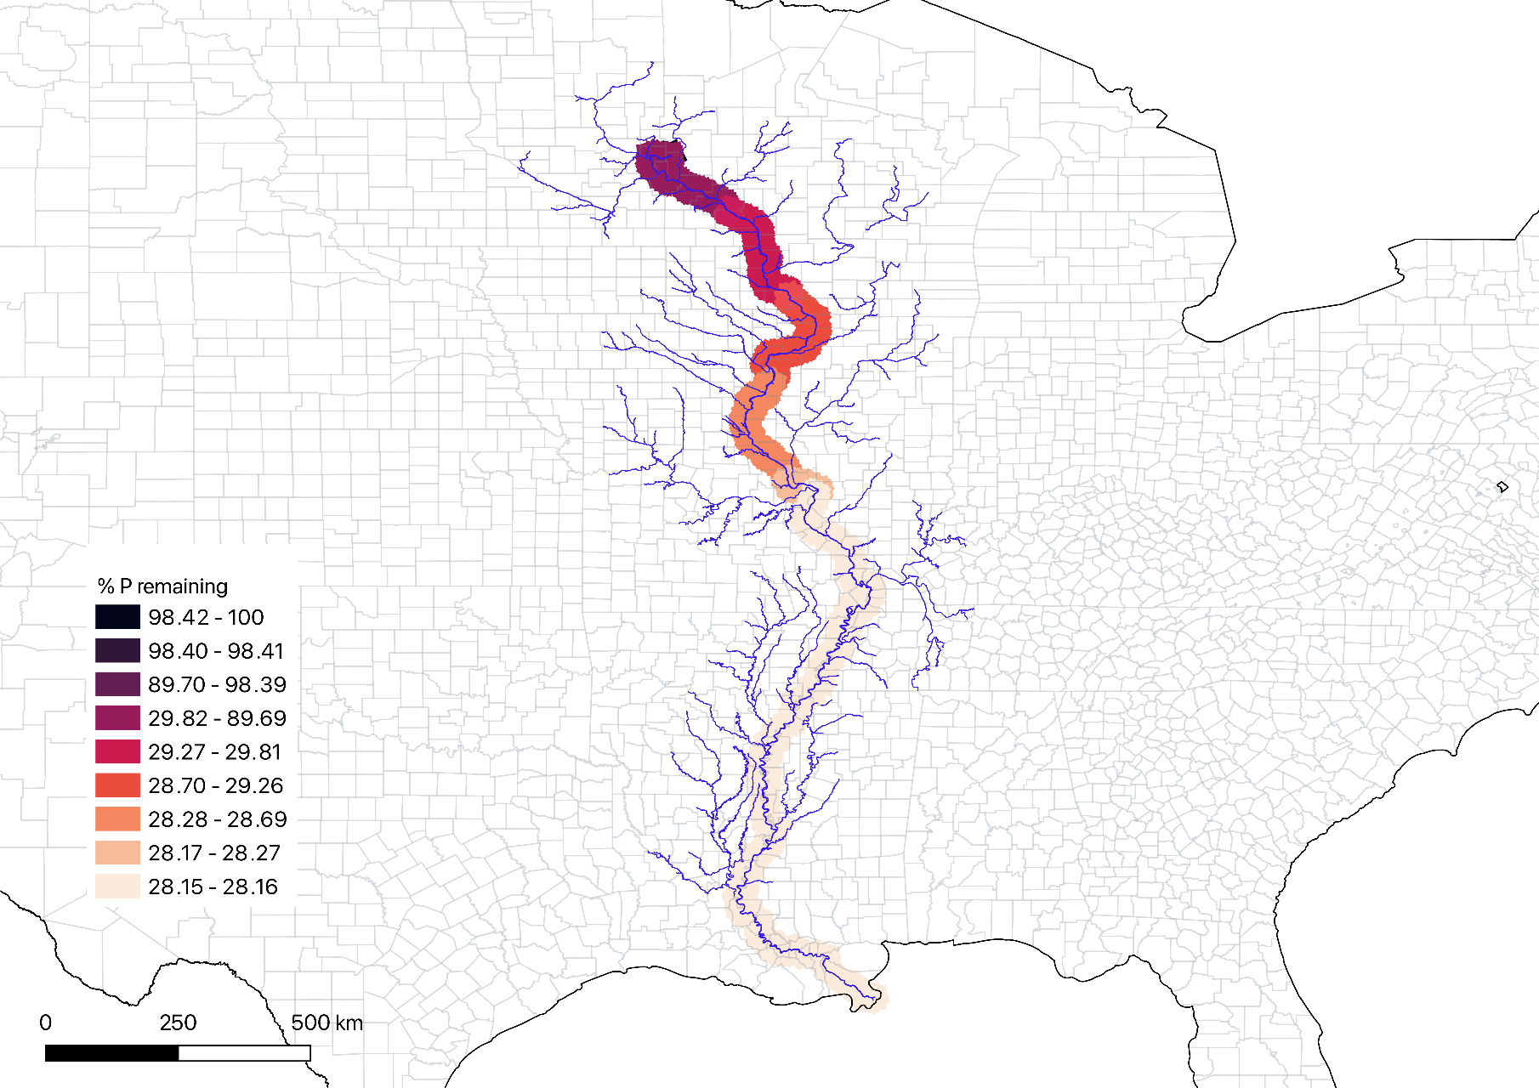
Fate and Transport: Mississipi Headwaters

Slide 24
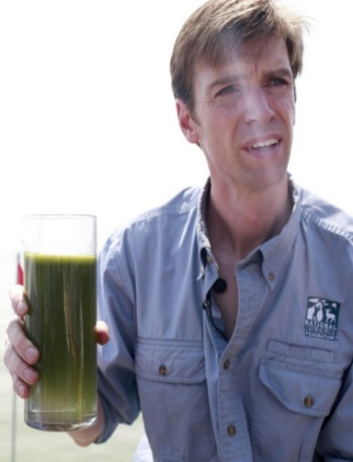
Drinking Water
Damages: Abatement costs to meet health standards and avoid shutdowns, residual health damages, health risks from untreated private wells
Nitrate Contamination
  64%(84,347) of Public Water Systems detected positive levels of Nitrate
  2.3% of the PWS reported detected Maximum Contaminant Level of Nitrate
  10.4 million people (4% of population)
HAB Contamination
“Toxin leaves 500,000 in northwest Ohio without drinking water”
REUTERS August 2, 2014

Slide 25
Drinking Water Community Water Systems
EPA: (SDWIS)
~50,000 CWS
Plant location (county)
Population Served
Water Source: Surface or Ground

Slide 26
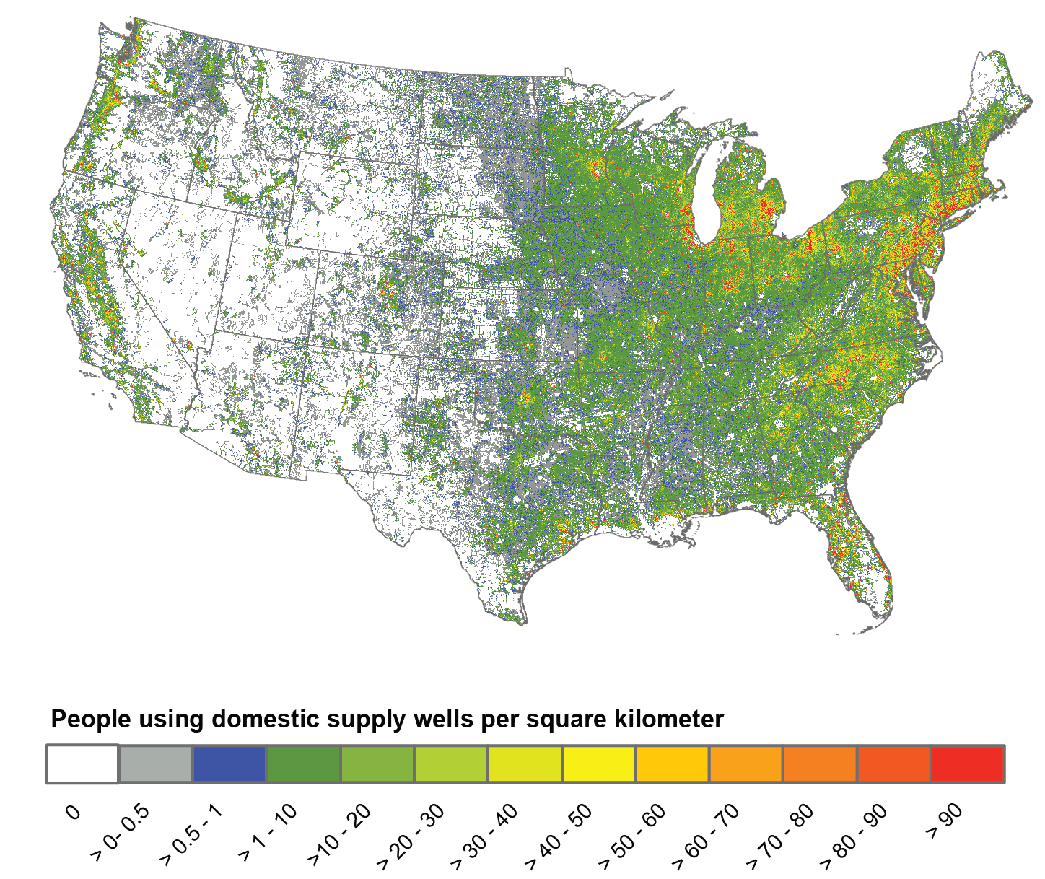
Drinking Water Private Wells
Private wells are water source for 40 million
About 14% of US Population
Little is known about overall water quality, but some evidence suggests inadequate testing

Slide 27


Outdoor Recreation
Damages: Recreational fishing, boating, wildlife viewing: Lakes, Rivers, and Streams
2020 Outdoor Participation Report by the Outdoor Foundation: About 13% of people in 2019 participated in freshwater fishing activities

Slide 28
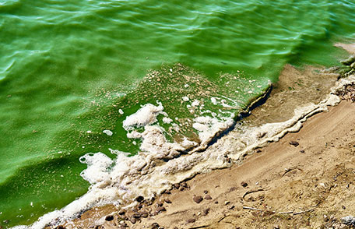
Outdoor Recreation: Contact
Contact recreation, swimming, wading, pets, Cathy paddle boarding: Lakes, Rivers, and Streams
CDC: Illness and symptoms from harmful algal blooms:
  Skin, eye, nose or throat irritation
  Abdominal pain
  Headache
  Neurological symptoms
  Vomiting
  Diarrhea

Slide 29

Outdoor Recreation Participation
55%
170.0
54%
165.6
53%
161.3
52%
156.9
51%
152.5
50%
148.1
49%
143.8
48%
139.4
47%
135.0
2022 OUTDOOR PARTICIPATION TRENDS REPORT
2007 2008 2009 2010 2011 2012 2013 2014 2015 2016 2017 2018 2019 2020 2021
% PARTICIPATING IN OUTDOOR REC
# PARTICIPANTS (MILLIONS)
GROWTH TRENDS. 2007 TO 2021
1

Slide 30





MOST POPULAR OUTDOOR ACTIVITIES
LEGEND
PARTICIPANTS
(MILLIONS)
ACTIVITY
CHANGE 2020 TO 2021
CAMPING
58.7
+889 thousand
BIKING
45.9 -2 million
52.4 -2.3 million
FISHING
64.5 +739 thousand
HIKING
2022 OUTDOOR PARTICIPATION TRENDS REPORT
51.4 -1.4 million
RUNNING
1

Slide 31
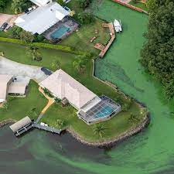
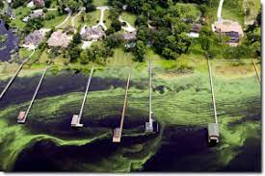
Aesthetic Values Near Homes
Damages: Local amenity aesthetics, odor, wildlife values to homeowners: Lakes, Rivers
https://www.epa.gov/sites/production/files/nutrientpollution/images/aerial_docks.jpg

Slide 32
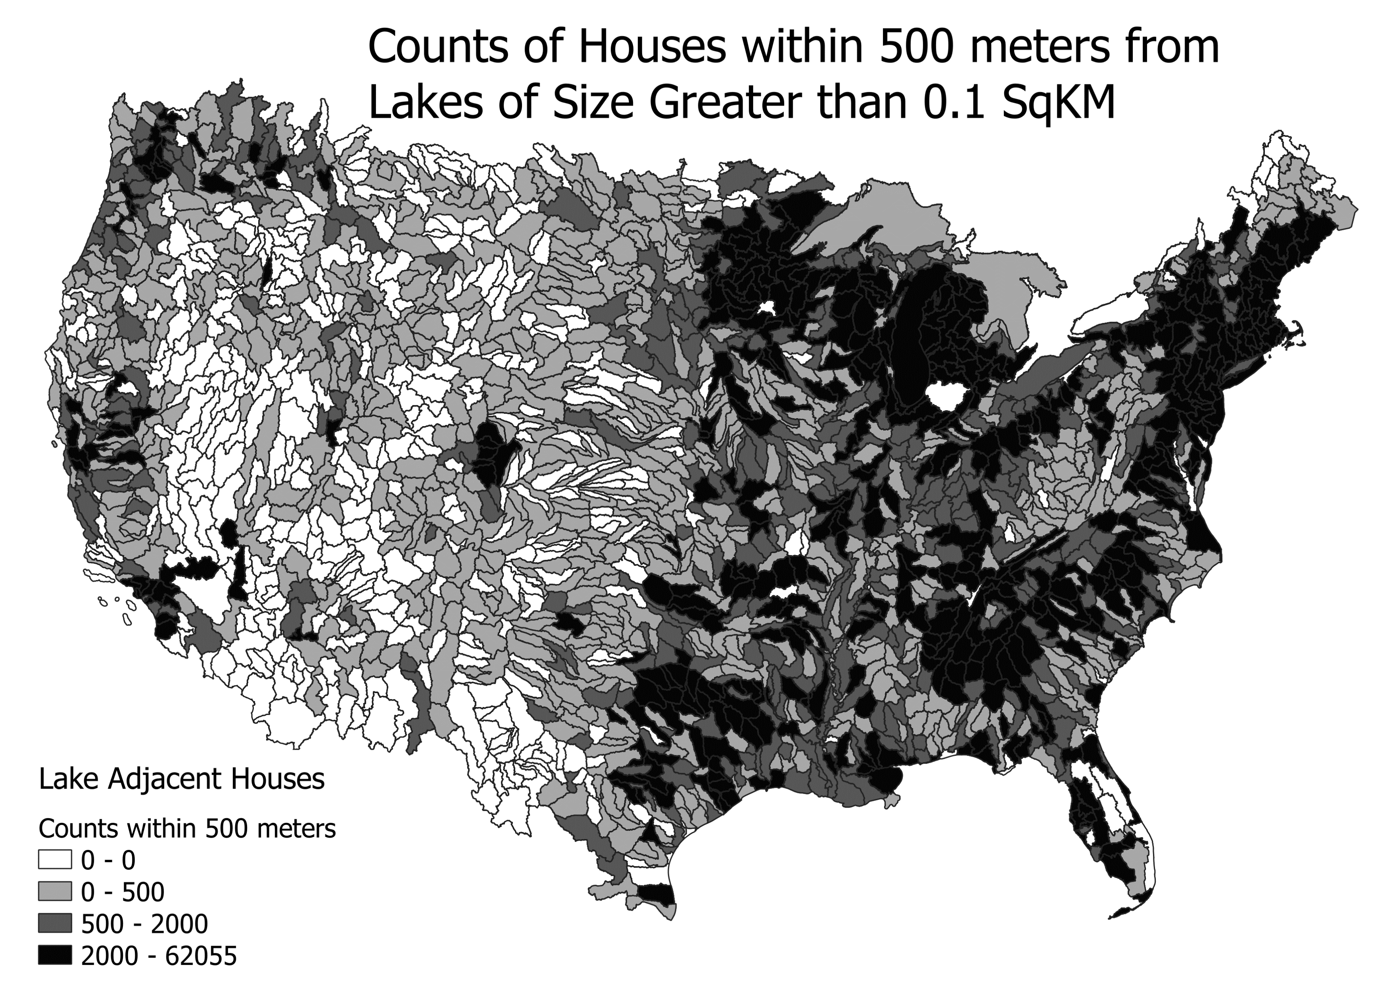
4.88 Million Houses are located within 500m

Slide 33
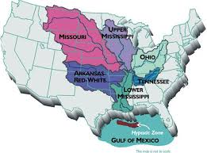
Other Uses and Categories of Benefits
5. Ecological Disturbances, coastal and freshwater hypoxic zones
6. GHG emissions from eutrophication natural sinks become sources
7. Iconic waterbodies
8. Cultural values, etc

Slide 34
III. Results
Marginal Damages by Location of Nutrient Pollution
Gross External Damages (GEDs) from nutrient pollution in the US
Contributing Sectors, Distribution Across Space, Local vs Exported Damages
Main Categories of Benefits Contributing
Nutrient pollution generates ~$140 billion GED annually… agriculture is the largest emission contributor, municipal wastewater plants are largest damage contributor, and recreation is main mechanism

Slide 35
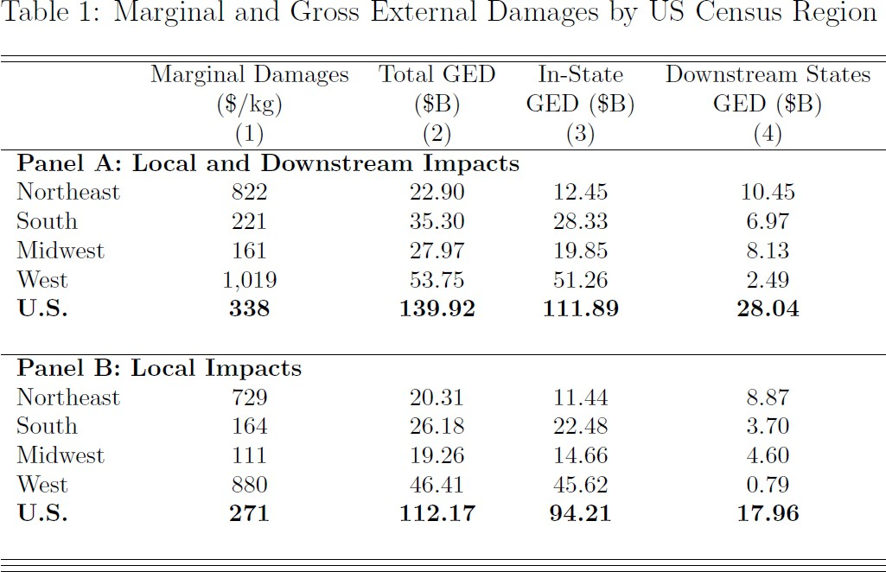
Results
Note: regional variation; local versus non-local damages; exported damages

Slide 36
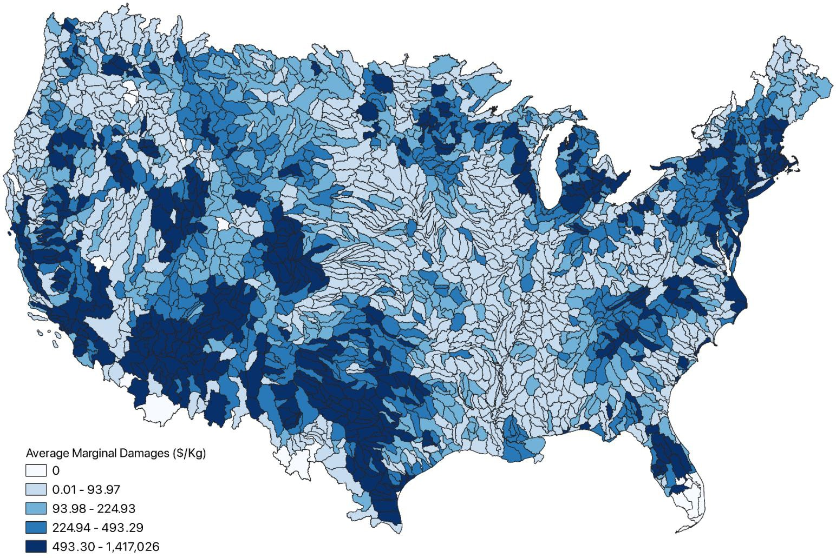
Marginal Damages by Location
Spatial variation: marginal damages occur where there are people

Slide 37
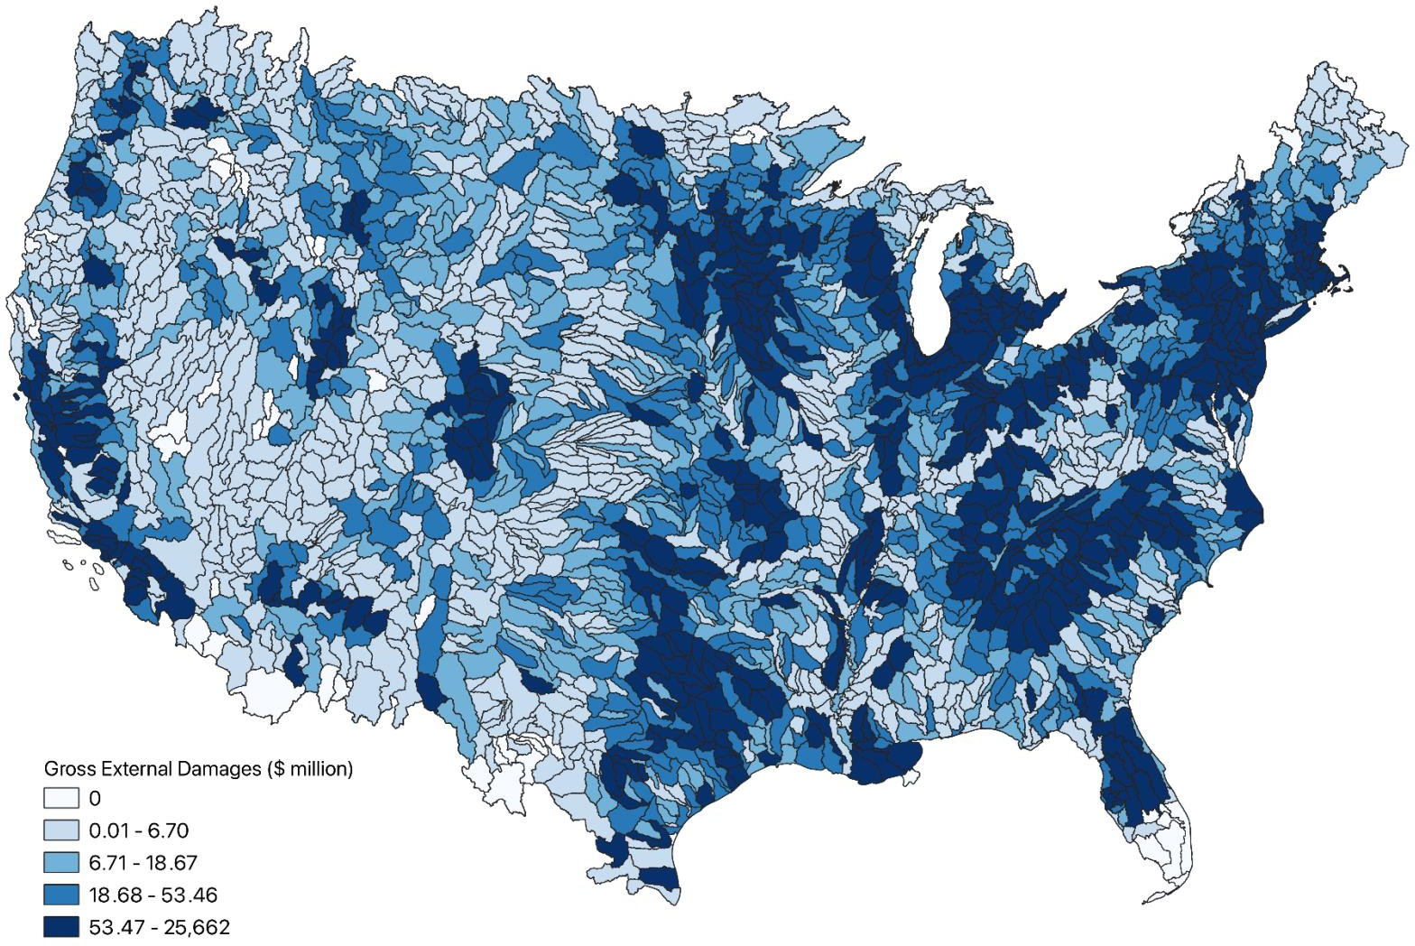
Gross External Damages
GED = MD x Emissions
Spatial variation: GED based on emissions and people

Slide 38
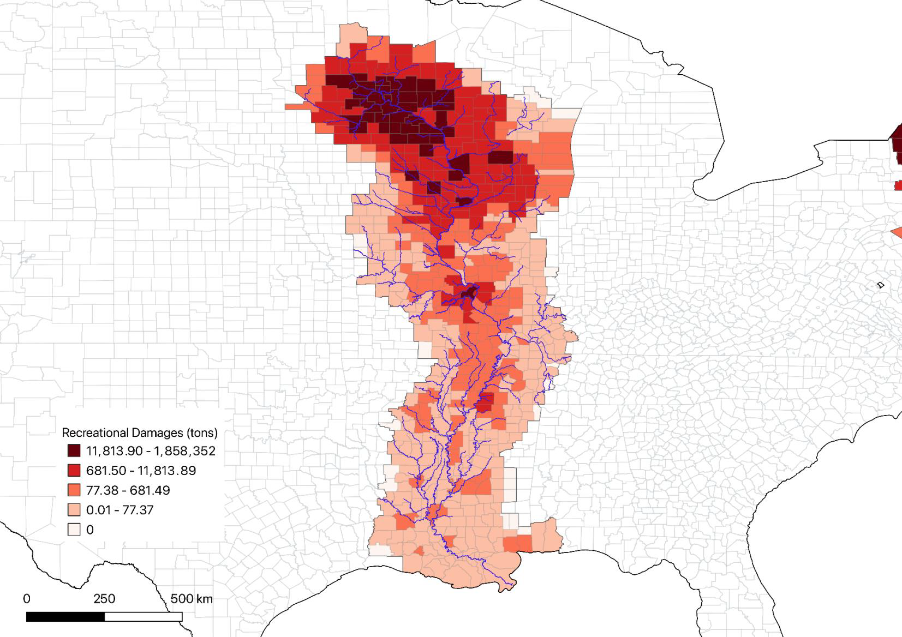

Slide 39
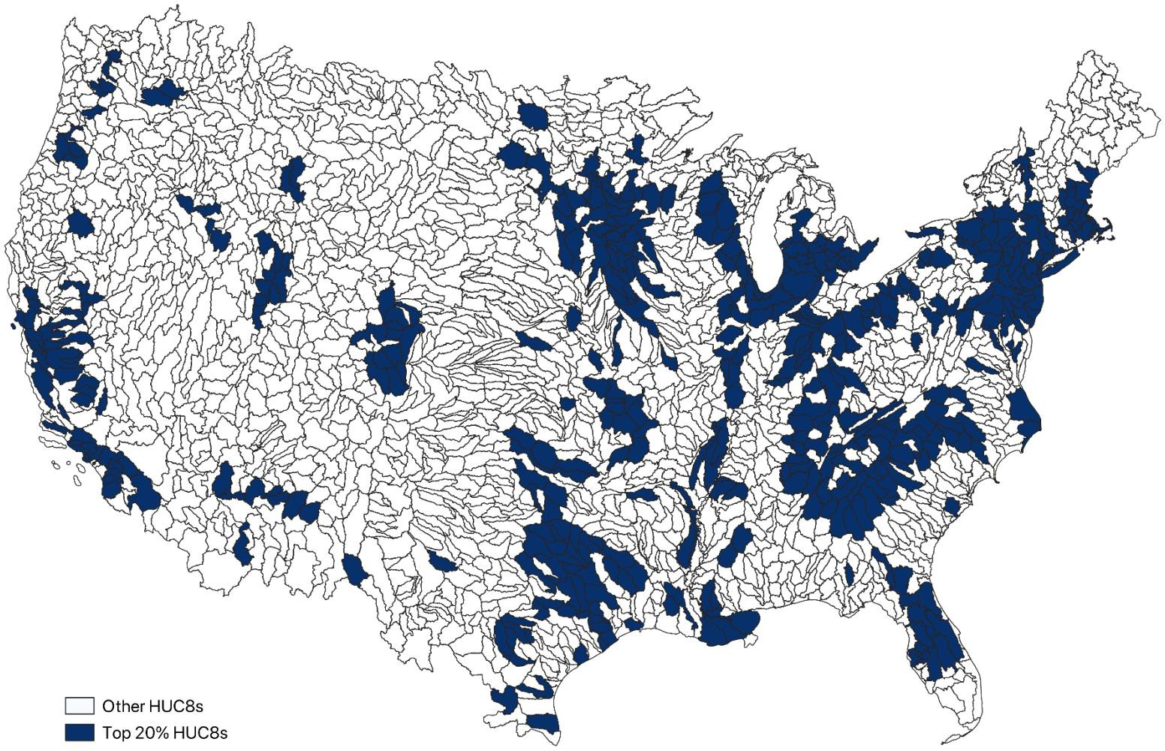
Damages are Concentrated
20 percent of GED-producing watersheds that generate 80 percent of damages

Slide 40
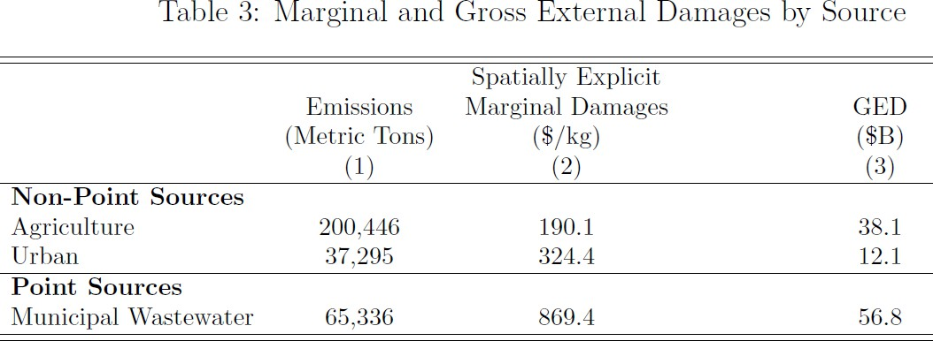
What Sectors Cause the Highest Damage
Agriculture produces more emissions, but municipal wastewater generates higher damages… ~41 percent and 27 percent of total GED respectively.

Slide 41
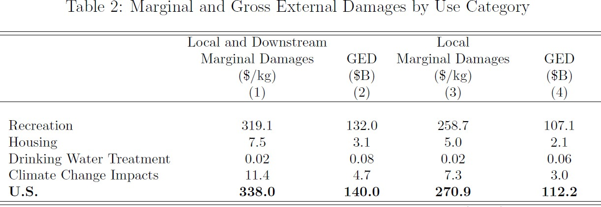
Recreation is Responsible for Bulk of Damages

Slide 42
Context for GED Estimates
 | Billions | Source
GED Nutrient Water Pollution | $140 (~1% of GDP) | This work
US GDP 2022 | $25,461 | https://www.statista.com/statistics/188105/annual-gdp-of-the-united-states-since-1990/
Agriculture GDP (2018) | $289 | https://www.statista.com/statistics/188105/annual-gdp-of-the-united-states-since-1990/
GED PM 2.5 2014 (Muller et al)¹ Nationwide Total Attributed to Agriculture | $790 (4.2% of 2014 GDP) $220 (largest sector) | https://doi.org/10.1073/pnas.1905030116
Outdoor Recreation 2021 | 1.9% of GDP | U.S. Bureau of Economic Analysis (BEA)
Residential investment (not just single family) | 3-5% of GDP | Housing’s Contribution to Gross Domestic Product - NAHB.
Water Utilities | 0.6% in 2017 | (Transportation and water infrastructures spending as share of U.S. GDP | Statista)
Outdoor Recreation | 2.2% GDP in 2022 | https://www.bea.gov/news/2023/outdoor-recreation-satellite-account-us-and-states-2022
1. Five constituent pollutants (H₃, NO_{x}, primary PM_{2.5}, SO₂, and VOCs)

Slide 43
Takeaways
About $140 billion GED from nutrient pollution (~1percent GDP)
80 % damages are local, 20% of damages are exported downstream
Concentrated damages, 80% comes from 20 % of watersheds
Agriculture is largest emitter – but not largest contributor to damages
Recreation is the dominant cost generating mechanism
But potentially significant omissions
  Health from contact recreation
  Health from drinking water

Slide 44
Environmental Economists have made Huge Strides Quantifying Air Damages
We are Behind for Water Pollution
USEPA “Nutrient pollution is one of America's most widespread, costly and challenging environmental problems….
www.epa.gov/nutrientpollution/issue

Slide 45
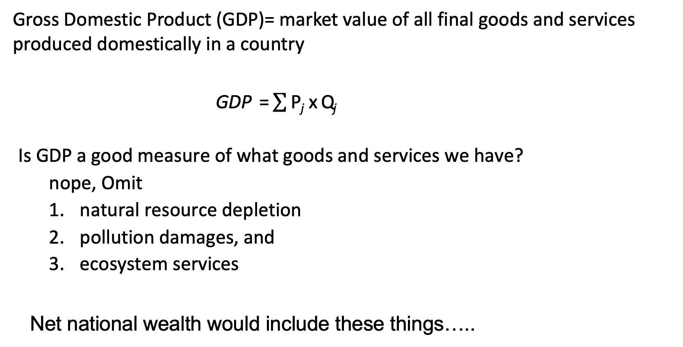
Measures of Economic Well-being
Gross Domestic Product (GDP)= market value of all final goods and services produced domestically in a country
GDP = $\sum{\text{P}\text{j} \text{x} \text{Q}\text{j} }$
Is GDP a good measure of what goods and services we have?
  nope, Omit
  natural resource depletion
  pollution damages, and
  ecosystem services
Net national wealth would include these things…..

Slide 46
3. Loss in services from nutrient pollution
Clean drinking water: Abatement costs to meet health standards and avoid shutdowns, surface water (omits groundwater, residual health damages, health risks from untreated private wells)
Leisure Consumption: Recreation
  Fishing, boating, wildlife viewing, swimming (omits contact recreation health effects and all rivers)
Local Amenities: Hedonics
Aesthetics, odor, wildlife habitat/abundance (omits rivers)
4. GHG emissions from eutrophication: Social Cost Methane natural sinks, lakes and farm ponds, become sources

Slide 47
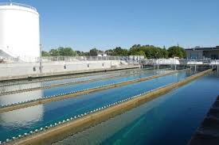
1. Social Costs: Drinking Water Systems
Mosheim and Ribaudo (2017) estimate marginal cost of Nitrogen removal, 360 drinking water treatment plants, estimates by EPA region and system-size
Information on Water System from EPA (Safe Drinking Water Information System)
  (i) Geo-Location, city, county
  (ii) Size of Serving Population
  (iii) Source of Raw Water
Match drinking water plants to population served via census tract

Slide 48
Community Water Systems
EPA: (SDWIS)
~50,000 CWS
Plant location (county)
Population Served
Water Source: Surface or Ground

Slide 49
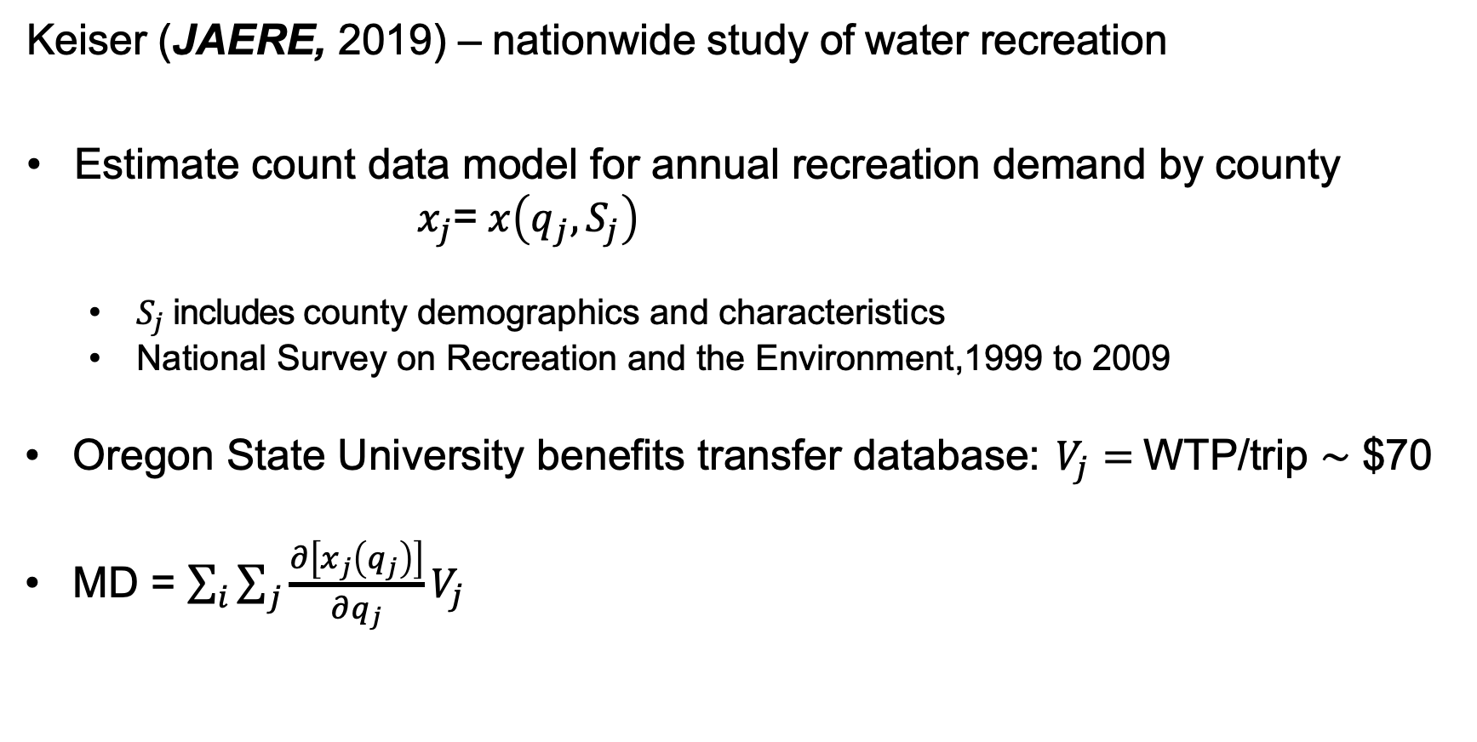
2. Social Costs: Recreation Damages
Keiser (JAERE, 2019) – nationwide study of water recreation
Estimate count data model for annual recreation demand by county
$x_{j}$= $x\left(q_{j},S_{j}\right)$
  $S_{j}$includes county demographics and characteristics
  National Survey on Recreation and the Environment,1999 to 2009
Oregon State University benefits transfer database: $V_{j}=$WTP/trip $\sim$ $70
MD = $\sum_{i}{\sum_{j}{\frac{∂\left[x_{j}\left(q_{j}\right)\right]}{∂q_{j}}V_{j} }}$

Slide 50
3. Social Costs: Hedonics
Valuing water quality in the US using a national data set on property value, PNAS, Mamun et al. (2023)
  674,000 property transactions near 1,632 lakes in continental US
  Secchi depth (clarity) as measure of quality
  η=0.16 for properties < 100m from shore
  η=0.045 for properties 100-300m from shore
Core Logic data – inventory of residential single-family homes in continental US:
  ~3.36 million homes within 300m of lakes > 0.1km²
  ~$781 billion assessed value (~$232,500 per home)
Baseline clarity predicted based on regression of Secchi depth on TN and TP

Slide 51
4. Nutrients and GHG Emission from Lakes
TP loading → increase CHLA concentration in lake j → increase CH4 emissions based on size of lake j → climate damages/benefits based on social cost of methane (SCM)
Upscaling predictions from Beaulier et al. (2018):
log₁₀ (CH₄ ) = 0.778log₁₀ (CHLA) + 0.940
  CH4 – total methane emissions per day per m² of surface water
  CHLA – chlorophyll a concentration in µg/l
SCM ~$1300/ton in 2020 dollars for 2020 emission

Slide 52
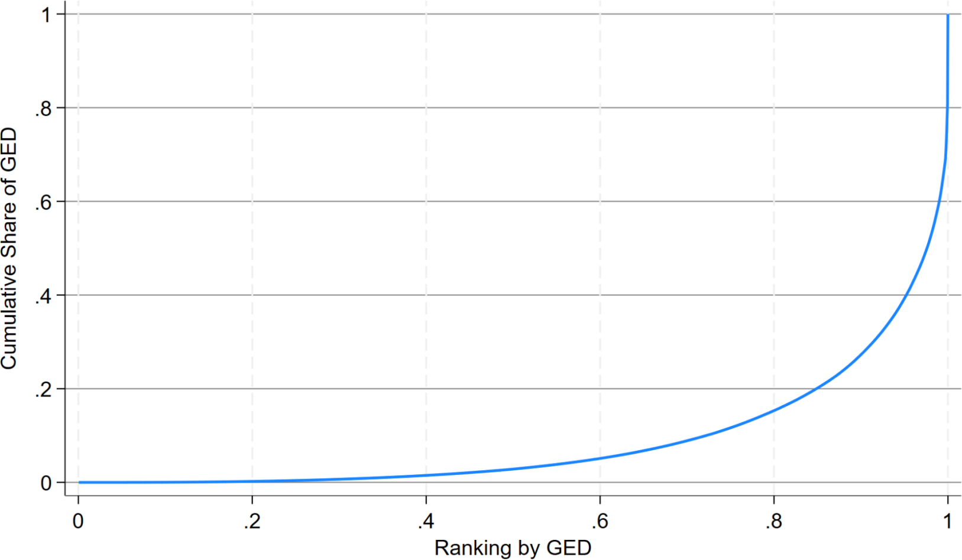
Damages are Highly Concentrated
~80 percent of damages come from ~20 percent of watersheds

