Slide 1
Tradeoffs in Achieving TMDLs – Ecosystem Services and Cultural Values in the Chesapeake Bay
Lisa A. Wainger¹, George Van Houtven², Ross Loomis², Jay Messer³, Marion Deerhake²
¹ University of Maryland Center for Environmental Science, Solomons, MD
² RTI International, RTP, NC
³ Retired; formerly of US EPA Office of Research and Development

Slide 2
Collaborators
EPA ORD – Lisa Wainger, Jay Messer, Rob Wolcott, Andy Almeter
RTI – George Van Houtven, Marion Deerhake, Robert Beach, Dallas Wood, Mary Barber, Mike Gallaher, Jamie Cajka, David Chrest, Maggie O’Neill, Michele Cutrofello, Tony Lentz
Abt Associates – Isabelle Morin, Viktoria Zoltay

Slide 3
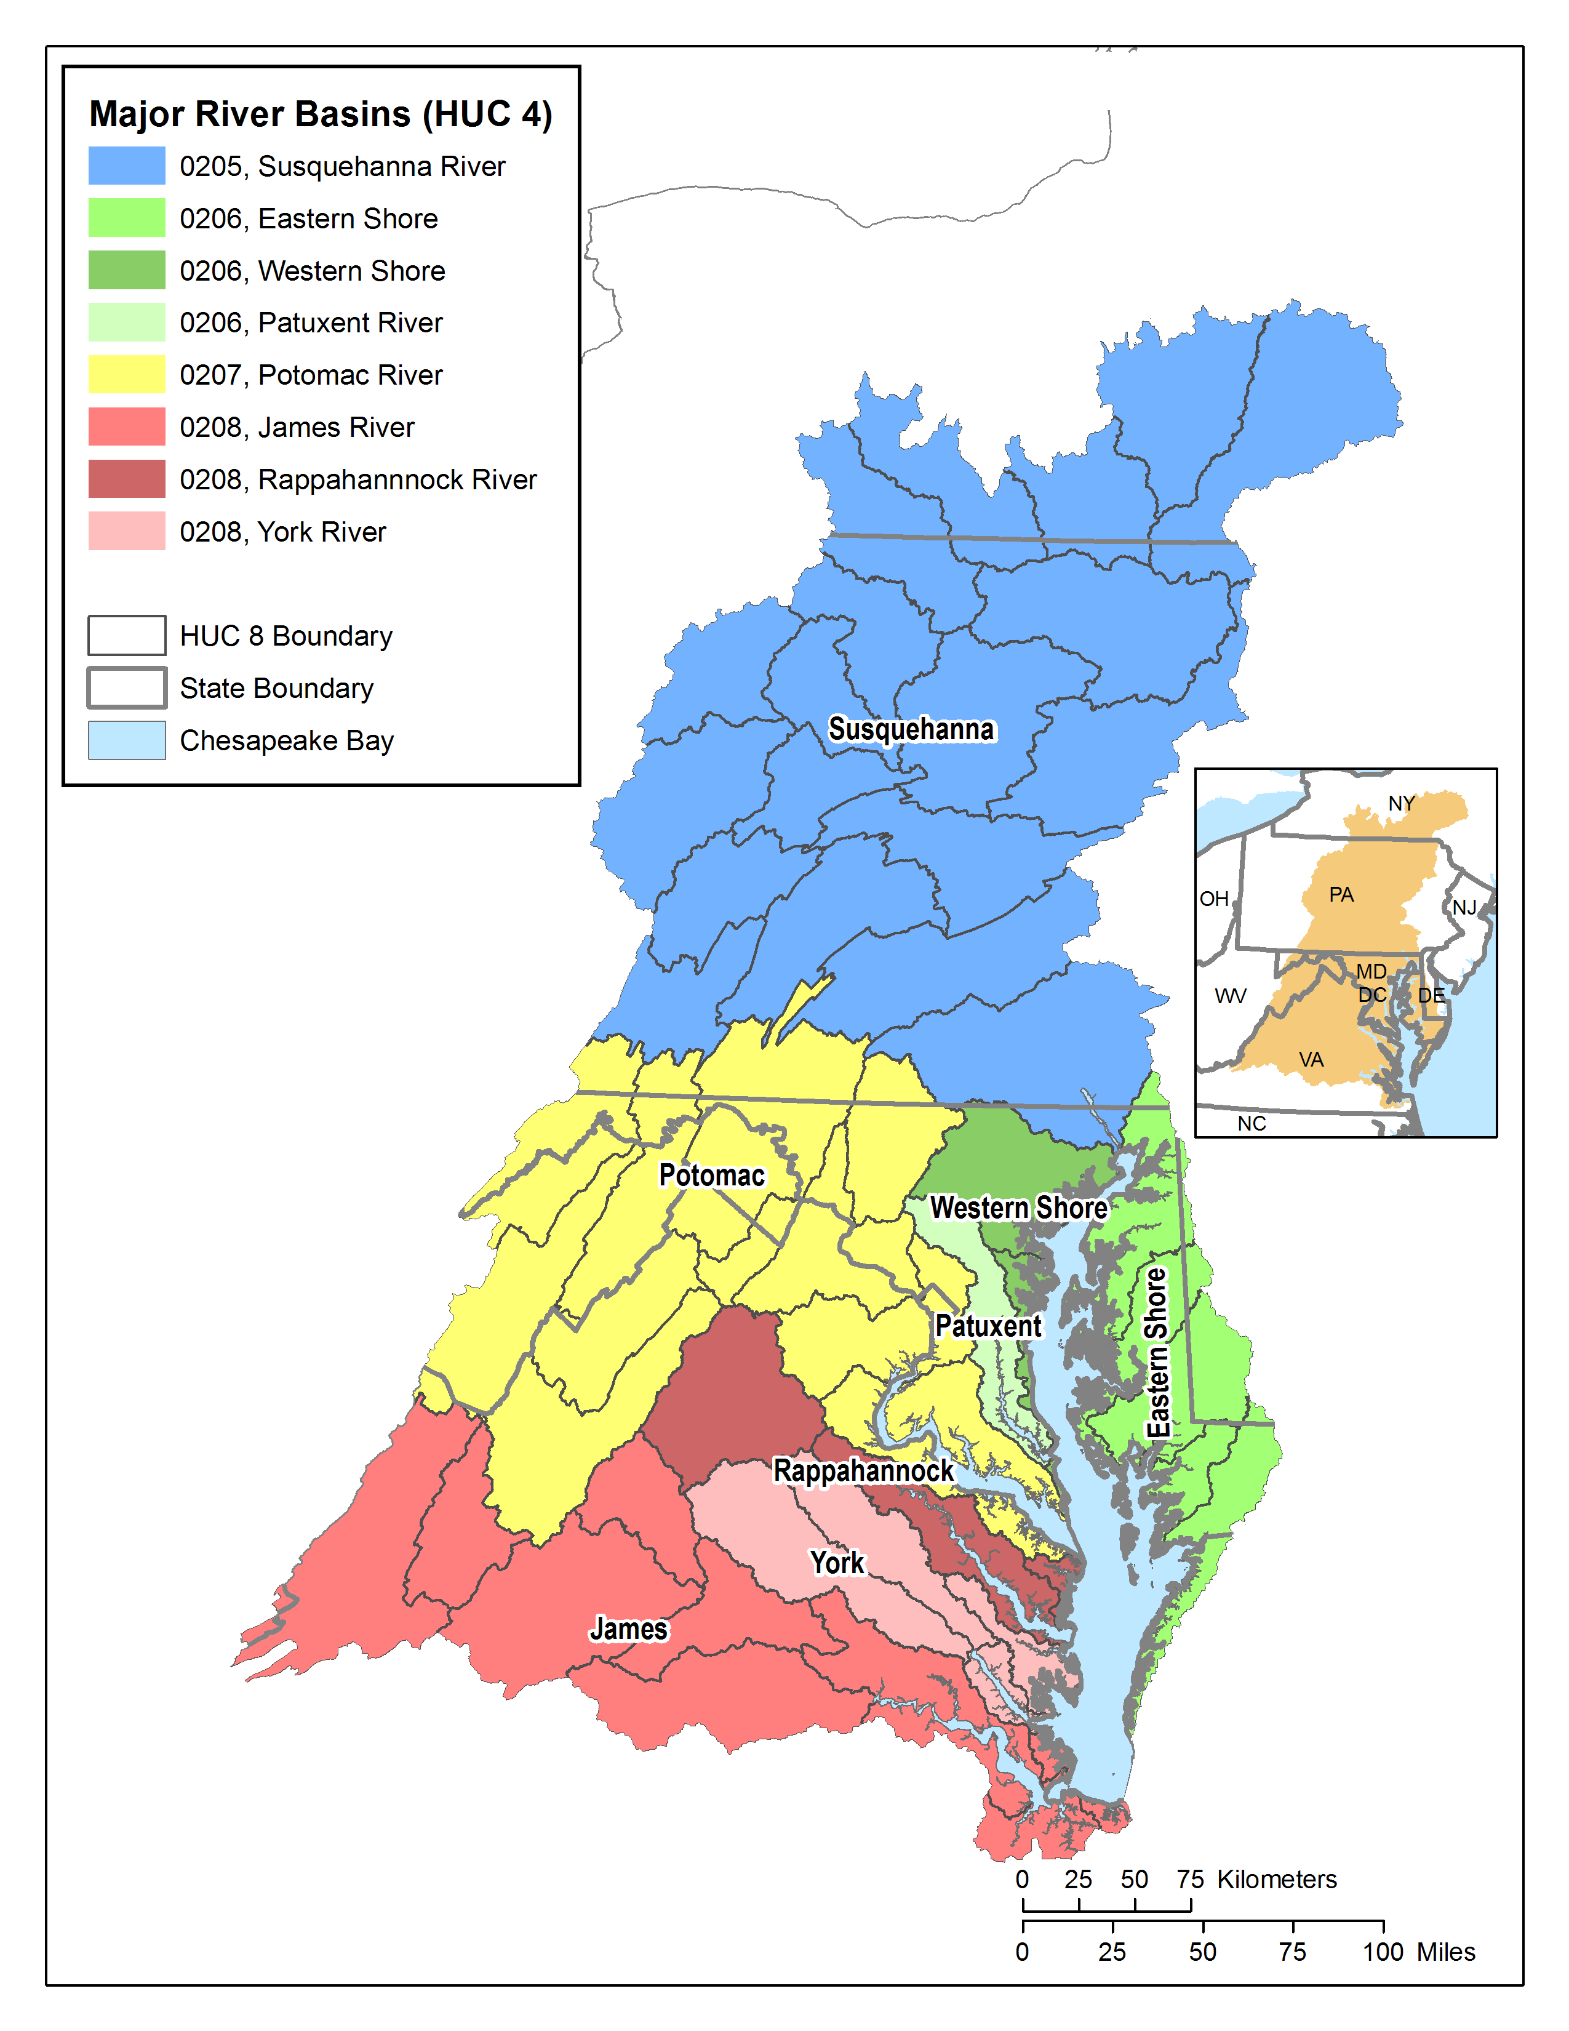
Case Study Area
The Potomac River watershed:
14,700 sq mile area
23% of CB watershed
97 significant municipal and industrial wastewater facilities
13% (1.2M acres) urban
26% (2.5M acres) agricultural land (crop and pasture)

Slide 4
Chesapeake Bay TMDL
TMDL jurisdiction and sector allocations were developed based on equity:
More reductions from watersheds with a greater impact on Bay water quality
More effort required from wastewater treatment facilities, equal effort required from all other sources
“Everyone doing everything everywhere” scenario defines maximum effort
Cost effectiveness and environmental co-benefits not considered

Slide 5
Questions to address
How do alternative policies affect:
Costs of achieving the TMDLs?
Generation of other ecosystem services?

Slide 6
Optimization Framework
Mixed integer linear programming (MILP) problem in the General Algebraic Modeling System (GAMS)
Relies on some data developed for and model output from the Chesapeake Bay Program’s Phase 5.3 Community Watershed Model (CBWM) (USEPA, 2010)
Includes new and newly synthesized data
Adapts existing models to quantify ecosystem service outputs
Uses benefit transfer to value services

Slide 7
Optimization Objectives - Least-Cost Solution
C_{ij} = Cost per acre of NPS practice i in location j,
A_{ij} = Acres of implementation of BMP i within land-river segment j;
V_{kl} = Cost of PS project k at plant l;
U_{kl} = 1 if project k at plant l is adopted, 0 otherwise
Subject to:
Reductions for all pollutants (TN, TP, sediment) ≥ Targets
A_{ij} ≤ available acres for NPS practice i
No more than 1 option k is used, per plant l

Slide 8
Costs, Co-Benefits and Net Costs
Ecosystem Service Co-Benefits
Costs of Control Projects
Net Costs

Slide 9
Optimization Objectives - Least-NET-Cost Solution
S_{n} = ecosystem service unit value
Q_{n} = units of ecosystem service provided
n = ecosystem service type

Slide 10
Management / Restoration Practices Included
Point Source Projects
POTW Advanced Nutrient Removal
Industrial Advanced Nutrient Removal
Nonpoint Source Urban Stormwater BMPs
Extended Detention Ponds
Bio-retention Planters
Urban Forest Buffers
Urban Grass Buffers
Urban Wetlands
Nonpoint Source Agricultural BMPs
Forest Riparian Buffers
Grass Riparian Buffers
Conversion to Forest
Natural Revegetation
Wetland Restoration
Livestock Exclusion
Winter Cover Crops
No-Till Agriculture
Reduced Fertilizer Application
No CAFO BMPs or Septic upgrades & hookups
Notes:
10

Slide 11
Annual Costs and Load Reductions for Urban Control Projects
Point Sources
3 “tiers” of wastewater treatment at significant municipal and industrial facilities
Costs and removals based on EPA analysis of point source controls in the Chesapeake Bay watershed
Urban Stormwater BMPs
Based on Abt Associates (2010)

Slide 12
Annual Costs and Load Reductions for Agricultural BMPs
Costs include
Installation and operation & maintenance (O&M) based on literature review and summary
Land costs (county-level avg. rental rates for crop or pasture land)
Nutrient/sediment removals based on CBWM and other sources
Notes:
Cost effective – grass buffers – least cost – land retirement and conversion to forest

Slide 13
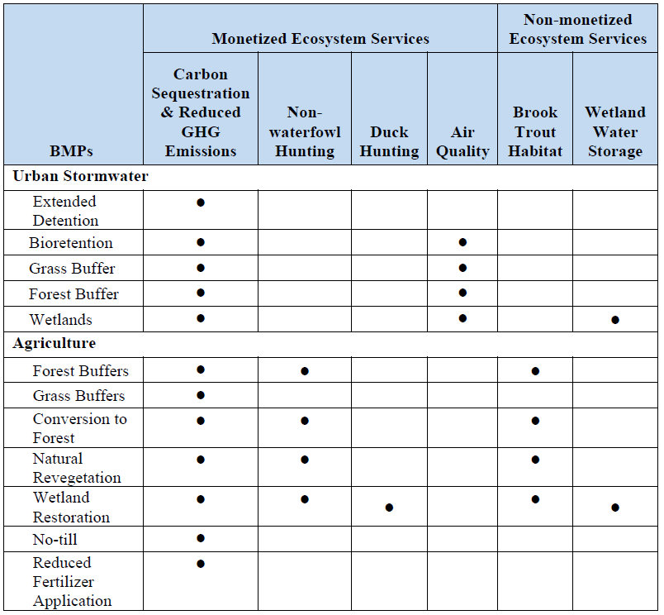
Ecosystem Service Co-Benefits by BMP

Slide 14
Model Scenarios
Restrictions on agricultural land conversion and increased agricultural land rental rates
Required reductions from urban sources
Higher credit ratio for NPS reductions
Notes:
Why?

Slide 15
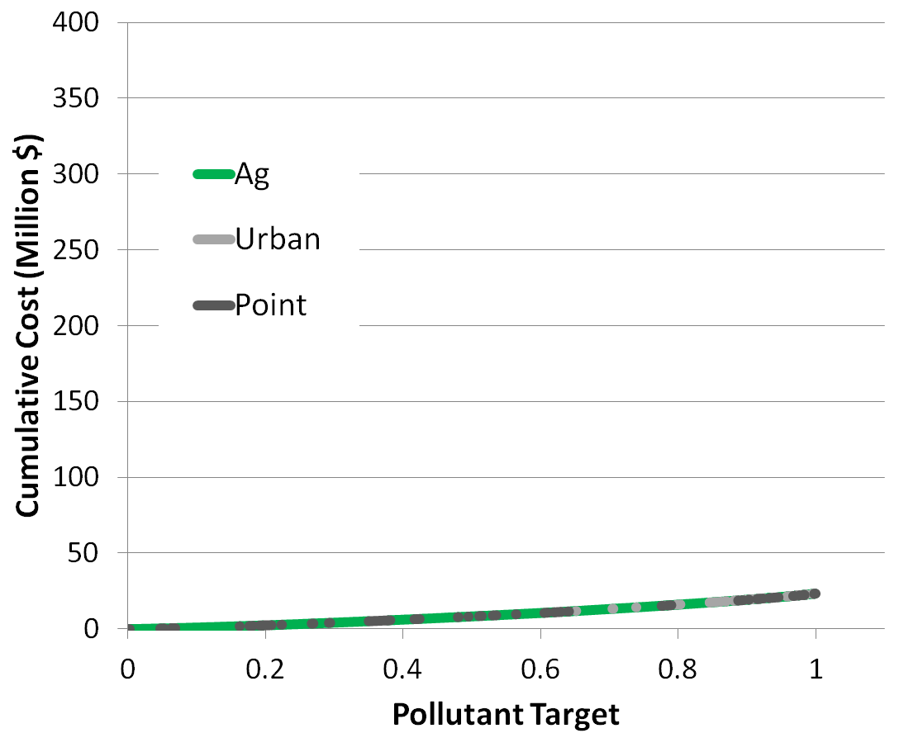
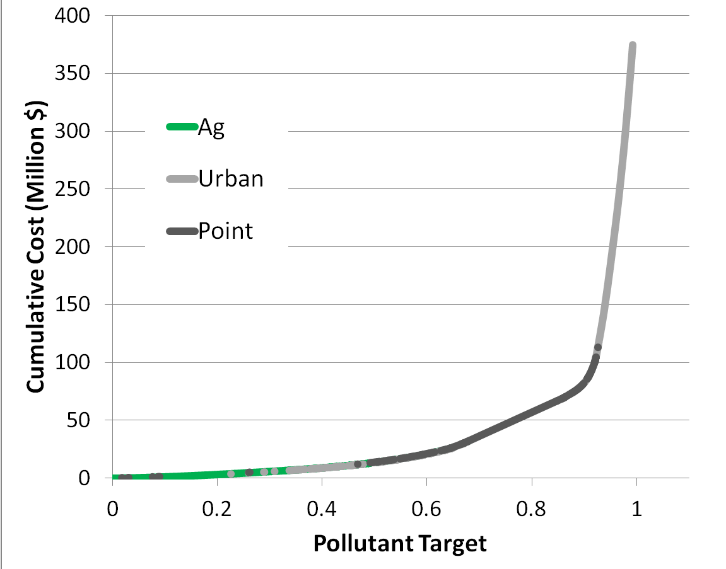
Effects of Restricting Agricultural Land Conversion on Cumulative TMDL Costs
Unrestricted Base Case 10% transaction costs; 1:1 NPS:PS
No ag conversion beyond 100’ buffers
$12M ES co-benefits
$4M ES co-benefits

Slide 16
Effects of Alternative Agricultural Policy on Least-Cost Mix of NPS Practices
Notes:
15% reduction in conversion with 2.2 times rental rates

Slide 17
Effect of Urban Allocation on TMDL Costs
$10M ES co-benefits
$12M ES co-benefits
Notes:
Ecosystem services reduce slightly (11 to 10 million from 0% to 20%). Still bringing in high co-benefits from remaining agricultural land.

Slide 18
Effect of Credit Ratios (NPS:PS) on TMDL Costs and Net Costs

Slide 19
Results Summary
A least-cost TMDL allocates the vast majority of effort in the Potomac Basin to agricultural BMPs
Roughly 50:50 mix of working lands and land conversions from base scenario with 1:1 credit ratios, 10% transaction costs, and 1X rental rates
Restrictions on ag land conversion or higher rental rates result in the substitution of working land BMPs
Highest ecosystem services from BMPs that convert agricultural land
Working land options highly cost-effective compared to gray infrastructure & produce co-benefits
Low NPS:PS credit ratios produce the most cost savings but high credit ratios result in more ES co-benefits

Slide 20
Questions?
EPA Report http://www.epa.gov/research/docs/chesapeake-bay-pilot-report.pdf
Contact:
Ross Loomis
Economist
rloomis@rti.org

Slide 21
TMDL Allocations as Load Reductions Targets by Basin
Million lbs

