Slide 1
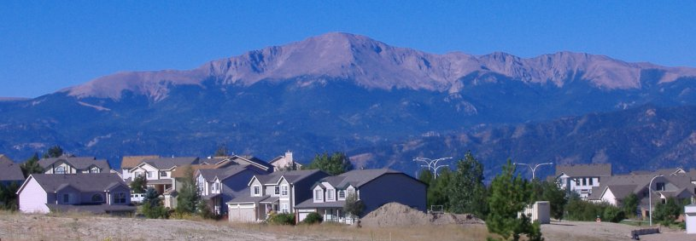
Marginal Implicit Prices for Federal Land Proximity:
A Comparison of Local and Global Estimation Techniques
Charlotte Ham, John Loomis, Patricia Champ, and Robin Reich
Project funded through a partnership between US Forest Service Rocky Mountain Research Station and the CSU Center for Environmental Management of Military Lands
Presentation for Camp Resources by Charlotte Ham, 8/7/2012
Notes:
Picture: Pikes Peak as seen from the grounds of the Briargate YMCA in the northeast section of Colorado Springs.

Slide 2
Past Research on Federal Land Proximity
National Forests
Positive effects were found for proximity to national forest land in the Appalachian highlands (Cho et al., 2009), in Arizona and New Mexico (Hand et al., 2008), and near McDonald-Dunn Research Forest in Oregon (Kim and Johnson, 2002).
Negligible effects were found on house prices near Arapaho-Roosevelt National Forest in Northern Colorado (Kling et al., 2007).
Negative effects were found after two fire incidents in Angeles National Forest in California (Mueller and Loomis, 2008) and from visible clear-cut in the Oregon study (Kim and Johnson, 2002).
Military Lands
In Central Maryland, a price premium was found only for the largest of the installations, Fort Meade; other military land proximity measures were insignificant (Irwin, 2002).
Notes:
Past studies have explored the relationship between public lands and housing prices to estimate price differentials for characteristics of the house, a market good, as a method to partially quantify the environmental benefits (costs) for neighboring residents (Cho et al. 2009; Hand et al. 2008; Irwin 2002; Kim and Johnson 2002; Neumann et al., 2009; Shultz and King 2001). Property values adjacent to public lands may yield price premiums (discounts) impacting local budgets through the increase (decrease) property tax revenues impacting local budgets.
Relatively few open space studies have focused on the value of open space amenities provided by federal lands. Comparability across studies is challenging because real estate markets are unique with varying preferences for open space and availability of substitutes.
National Forests
Positive effects were found for proximity to national forest land in the Appalachian highlands (Cho et al., 2009), in Arizona and New Mexico (Hand et al., 2008), and near McDonald-Dunn Research Forest in Oregon (Kim and Johnson, 2002).
Negligible effects were found on house prices near Arapaho-Roosevelt National Forest in Northern Colorado (Kling et al., 2007).
Negative effects were found after two fire incidents in Angeles National Forest in California (Mueller and Loomis, 2008) and from visible clear-cut in the Oregon study (Kim and Johnson, 2002).
Military Lands
In Central Maryland, a price premium was found only for the largest of the installations, Fort Meade; other military land proximity measures were insignificant; and publicly held non-military open space effects were significant and negative (Irwin, 2002).

Slide 3
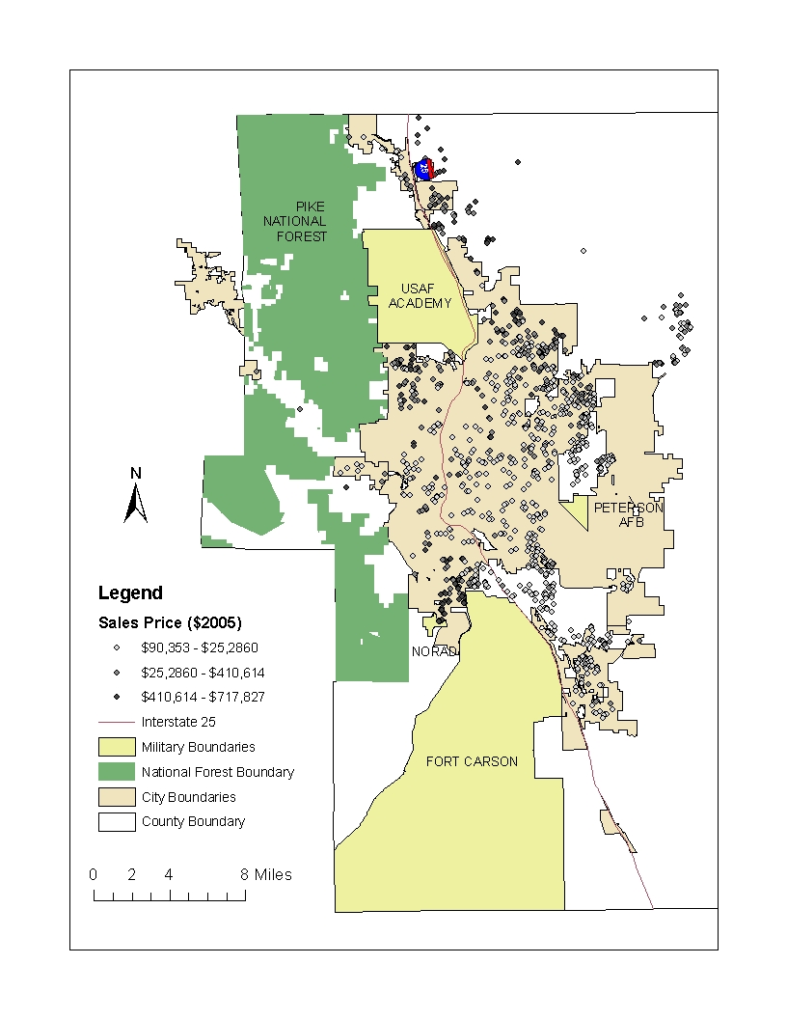
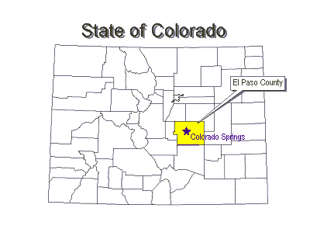
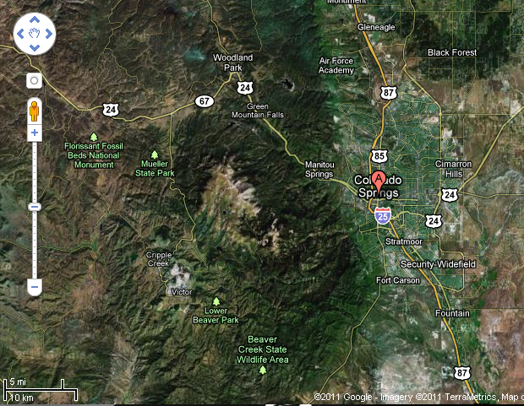
Study Area
El Paso County, CO
Notes:
El Paso County, Colorado, is located along the eastern edge of the southern Rocky Mountains 70 miles south of Denver where the Southern Rockies and Southwestern Tablelands Ecosystems meet. The western portion of the county is extremely mountainous, composed of igneous Pikes Peak Granite and home to Pikes Peak (14,110 feet) and the Pike National Forest. From west to east there is a 9,000 foot change in elevation leveling out to prairie land with dairy cows and beef cattle. The climate ranges from alpine to desert resulting in much diversity in flora and fauna along with varying precipitation levels and temperatures.
El Paso County is approximately 2,158 square miles and the western portion is the study area. According to 2006 Census data, the county population totaled 576,884 people and population density was estimated 271 persons per square mile (compared to the state average of 46). The county contains the cities of Colorado Springs, Fountain, Manitou Springs; towns of Monument, Palmer Lake, Calhan, Green Mountain Falls, and Ramah.

Slide 4
Hedonic Pricing Method
Differentiated good
Hedonic price function
Implicit price of attribute

Slide 5



P=f(S,N,L,T; α,β,γ,δ)
P = αS + βN +γL + δT+ ε ε ~ N(0,σ²I_{n} )
Empirical Model
House structural variables:
House(+), lot (+), garage (+) and basement (+) square footage,
age of house (-), and # of bathrooms (+)
Neighborhood factors:
School districts: Academy, Cheyenne Mountain, Falcon
Fort Carson, Harrison, Lewis Palmer, Manitou Springs
Widefield and Colorado Springs
Location/environmental variables:
Distance to different federal lands:
Amenity (-) Disamenity (+)
Market timing variables: continuous
Notes:
Residential property sales transaction information was obtained from the El Paso County Tax Assessor. The data included parcel level information on sale prices, sale dates, and structural characteristics of the property with spatial coordinates. Housing structural characteristics include the year the house was built, the square footage of the house, lot, basement and garage, along with the number of bedrooms and bathrooms. The number of bedrooms was found to be highly correlated with the square footage of the house; therefore the house square footage variable was selected. The total number of house sales over the 2005 to 2007 time frame was 31,414.
As the decision to purchase a home occurs when the buyer enters the contract approximately two months prior to the sales date, we subtract 60 days from the sales date to represent the decision date, e.g. the sales in March 2005 were entered January 2005 (Loomis and Feldman, 2003). Using the date of the decision, we calculated the age of the house and the age squared to capture any premiums or discounts for older homes and created dummy variables to differentiate new homes. Additional discrete measures capture market timing by the year of the sale with 2005 as the reference to which we compare 2006 and 2007. Because homes on more than an acre are potentially developable, we only include homes on one acre or less (Heimlich and Anderson, 2001; Lewis et al., 2008). Next, we trimmed the bottom and top 1% of sales to remove outliers and transactions that are not considered arms length, such as transactions among family members at less than fair market price. Then, we adjusted the house sales prices using the consumer price index to make comparisons in 2005 dollars.
Neighborhood demographic information was obtained through the United States Census website. Median income levels, mean time to work, percentage rental properties, percentage without high school education, percentage over 60 years old, population, and mean house price at the census tract level are the neighborhood variables expected to influence the purchaser’s decision that are considered. The Census tract shapefile available from the website provides the spatial reference for El Paso County and the variables are appended as attributes to the census tracts layer using ArcGIS software. Among census tracts for the county, the median housing value was $154,700. The difference between these estimates and our data may be due to aggregation effects over tracts decreasing the actual variances or because the deletions mentioned earlier relating to lot size and arm’s length transactions.
Measures that represent location were obtained from multiple sources. First, the El Paso County Assessor website has many shapefiles available free from their website. Boundaries for the county, cities, school districts, military lands, national forest land and roads were accessed. The second data source was the Colorado Ownership and Management Project (COMaP) spatial database that provides comprehensive information about Colorado open spaces including land ownership and levels of protection. Open space types in El Paso County include agriculture, community separators, greenway/stream, local parks, state parks, and urban open space. The percentages of homes within distance intervals for each open space type are provided in table 1. Agricultural land was defined using the National Land Cover dataset which has explicit values for agricultural land, however the nearest agricultural land was at least 5 miles from the nearest house in the study area.
The primary objective of this paper is to examine the relationship between house prices and distance to open space particularly from federal lands. To do so, dummy variables for houses within the first mile, between the first and second mile, and from the second to third miles are used to provide information about the per mile marginal effects of proximity to the national forest and each military land. Nonfederal open space types are included in the model using dummy variables to control for all forms of open space within a half mile.

Slide 6


Ordinary Least Squares Regression
Geographically Weighted Regression

Slide 7
Marginal Value as % House Price for Federal Land Proximity
Evaluated at the
Mean Price of $265,296:
[-$13,636,$23,556]
Tax revenue (7.7%):
[-$1,050,$1,814]

Slide 8
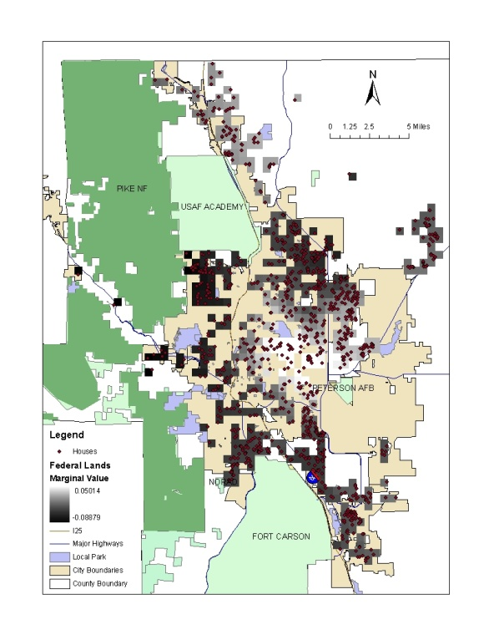
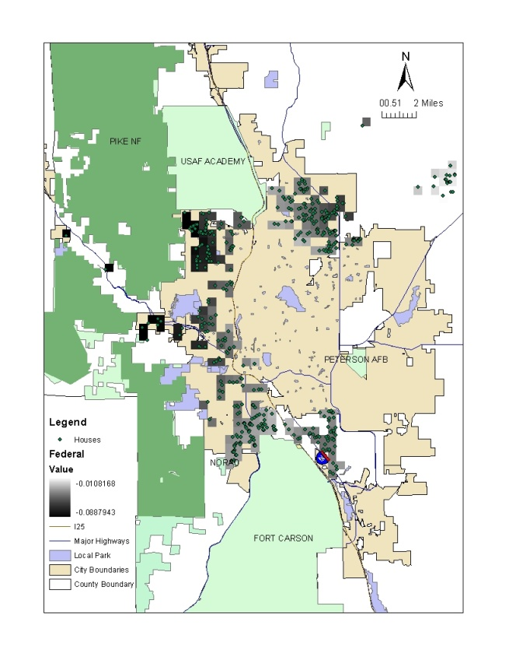
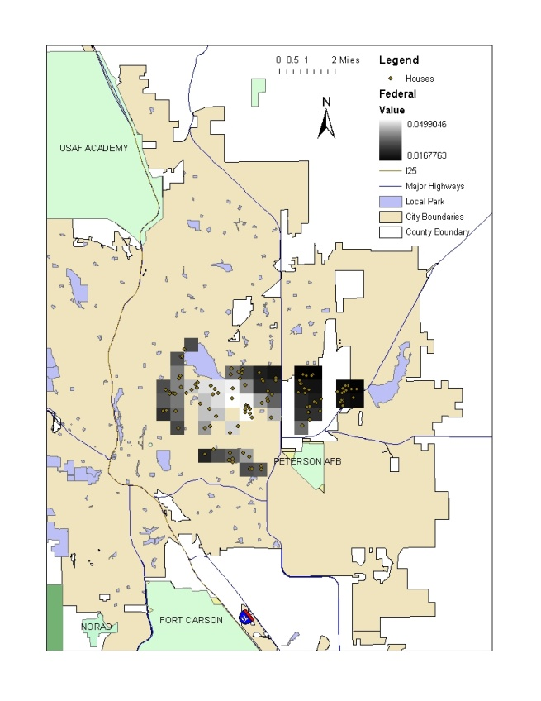
Amenity values for distance to nearest federal land
(1.678% to 4.99%)
Disamenity (11%)
(-8.879% to +5.014%)
(-8.879% to -1.082%)
Range (N=1,536)
Amenity (43%)

Slide 9

Conclusion
GWR as one way to address heterogeneity in implicit prices to avoid saying an attribute is not significant when it is the spatial heterogeneity that is masking the significance

Slide 10
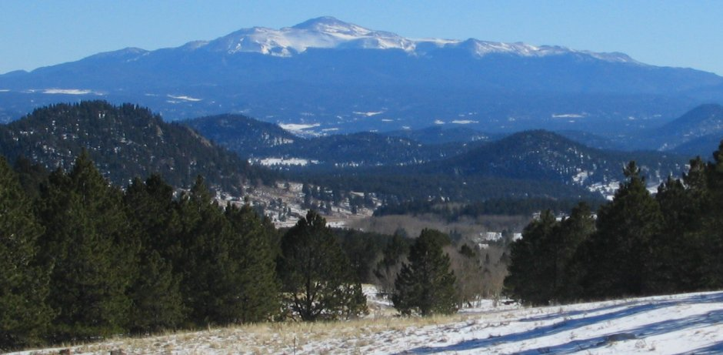
Other Research
Land Economics: characteristics of land uses matter
Land Use Policy: marginal values of open space proximity
Notes:
. Initial attempts have explained only approximately 30% of the variation in quantity demanded for house square footage by estimating the GWR with only housing structural variables and time (time as the instrumental variable).

Slide 11
Thank you!
Questions/Input

Slide 12
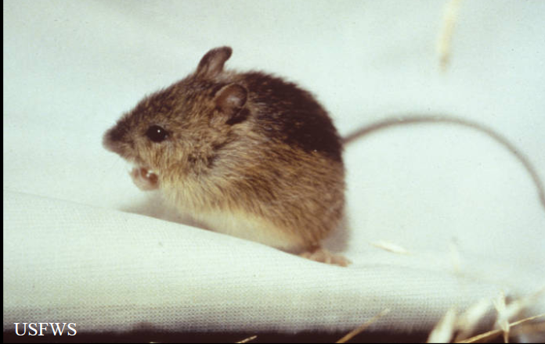
Shortcomings
Value of proximity to homeowners; not other use and non-use values
Error in variables
Case study
Scale of analysis

Slide 13
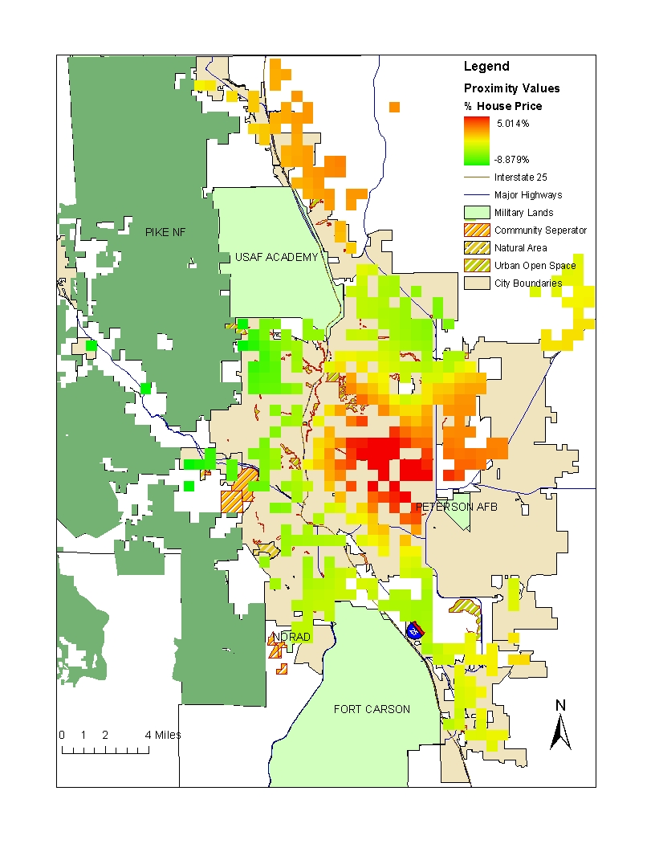
Amenity Values for Federal Land Proximity
As Percentage of House Price:
8.879% premium (green)
5.014% discount (red)
Evaluated at the
Mean Price of $265,296:
[-$13,636,$23,556]
Tax revenue (7.7%):
[-$1,050,$1,814]

Slide 15

The End.
Thank You!
Credits
Funders:
Project funded through partnership between US Forest Service Rocky Mountain Research Station and the Center for Environmental Management of Military Lands
Photographs:
Houses: Rick Van Wieren/PikesPeakGallery.com, Pikes Peak/PikesPeakGallery.com
Wildlife: ducks: Gary Kramer/ USFWS, preble’s meadow field mouse: USFWS
Natural: sunset and stream: Mike Bonar, Elk River Photography,
USAFA and Fort Carson websites, Google maps
Notes:
Picture: PikesPeakGallery.com Rick Van Wieren’s photo above of Pikes Peak as seen from the grounds of the Briargate YMCA in the northeast section of Colorado Springs

Slide 16


Paper 2
Marginal Implicit Prices for Federal Land Proximity: A Comparison of Local and Global Estimation Techniques
How do local and global model estimation techniques compare when applying the hedonic pricing method?

Slide 17


Models
Notes:
By observing home buying behavior across sites with varying degrees of environmental benefits, one can estimate the economic value that additional environmental benefits provide to homebuyers. The economic value is estimated in dollar terms because dollars are the common metric from which most resource allocation decisions are based. Researchers have employed various techniques to identify demand parameters from hedonic price equations in the market for homes (Blomquist & Worley, 1981; Palmquist, 1984), automobiles (Agarwal & Ratchford, 1980; Arguea, Hsiao & Taylor, 1993), and other goods. Two regression techniques are applied herein.
Ordinary Least Squares Regression
, (37)
where ln(y_{i}) is the natural log of the house sale price for house i; x_{ik} are house i structural, neighborhood, and location characteristics k. The error term ε_{i} is assumed to be independent and identically distributed with a mean of 0 when estimating the model using ordinary least squares.
, (38)
However, the condition is not expected to hold in housing markets because of known and unknown spatial autocorrelation. Thus, the alternative estimation method is the locally (geographically) weighted regression.
Locally Weighted Regression
, (39)
where (u_{i},v_{i}) represents the coordinates of the ith house in space, and β_{k}(u_{i},v_{i}) is the ith house contribution to the continuous function β_{k}(u,v).
, (40)
where is an estimate of β; X is a vector of house characteristics x_{ih}; Y is a vector of ln(y_{i}); W(u_{i},v_{i}) is an n x n diagonal matrix with diagonal elements; w_{ii} is the geographical weighting of the observed value of house i.
Classical regression equation,
(41)
where is a multiplication operator in which each element of is β multiplied by the corresponding element of X, and 1 is a conformable vector of 1’s. If there n homes and k explanatory variables including the constant, both β and X is of dimensions n x k. The matrix for the locally weighted regression consists of n sets of local parameters represented as,
, (42)
W(i) is an n x n spatial weight matrix of the form
(43)
where w_{ij} is the weight given to house j in the calibration of the model for house i. The diagonal elements of the weight matrix, w_{ij}, are equal to:
, (44)
Where d_{ij} is the Euclidean distance between house i and j, and b is the bandwidth. The bandwidth is the distance range for which the GWR is estimated. There is an important trade-off between bandwidth length and spatial heterogeneity representation: the longer the bandwidth, the less variation in coefficients across the landscape. At the largest bandwidth that covers the entire study area, coefficients become the mean in OLS. In this paper, the models are estimated in ArcGIS and the optimal bandwidth is selected iteratively by comparing Akaike Information Criteria (AIC) across models with varied bandwidth. The number of neighbors selected by AIC are compared to those when selecting by cross-validation.
(45)
The cross-validation (CV) approach is almost identical to least squares criteria estimated without house i (Cleveland, 1979). Then, an imposed distance of a half mile is examined to provide insight about how the estimates vary with variations in bandwidth.

Slide 18
Presentation Flow
Introduction
  Review past studies
Method
  Hedonic Property
Results
Conclusion
Next Steps

Slide 19
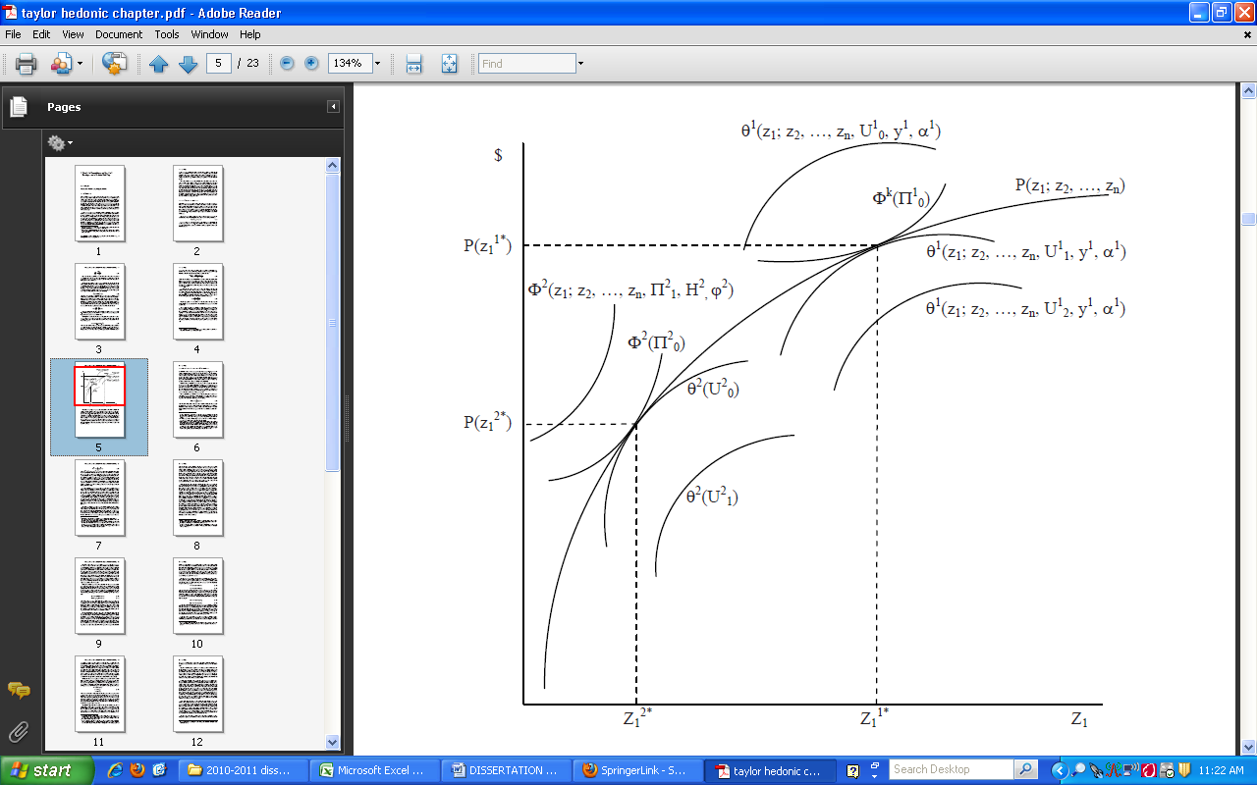
Hedonic Price Function
BUYER
SELLER

Slide 20

Spatial Components
Notes:
Spatial dependence occurs when observations across space are systematically related. The interconnection is more formally called spatial autocorrelation and a direct result of Tobler’s (1979) First Law of Geography that states “everything is related to everything else, but near things are more related than distant things.” One form of spatial dependence in hedonic price models occurs when house prices are based on comparable homes in the immediate vicinity such as within a half mile. The justification for using neighboring values in the calculation is that homes share the value of being located in a particular place such as near common environmental amenities or public services. A second form of spatial dependence called spatial error dependence may occur when an omitted variable is also correlated with the error of its neighbor and it is similar to serial correlation in time series data. Spatial error can also be due to measurement errors that may occur with overlapping data layers from multiple data sources or generally when the variable is hard to measure.
In the real estate industry it is common practice to assess a property’s value based on the prices of nearby homes (Can 1990). This process justifies the need to include a measure that specifies the interconnection between houses in close proximity through the form of a spatially lagged dependent variable. The spatially lagged dependent variable is composed of a spatial lag parameter, ρ, and a spatial weighting matrix, W. To determine if significant spatial autocorrelation exists due to the influence of neighbors, we look at the OLS residuals of the standard hedonic price model. Erroneously omitting the spatial lag term leads to biased and inconsistent estimation of coefficients (Anselin 1988). If a spatial pattern is in the residuals of the OLS model, then we want to include the information as an additional explanatory variable. If spatial autocorrelation is significant, the lagged dependent variable, ρWP, provides spatial structural information to the model thus reducing omitted variable bias and improving efficiency of estimators. If ρ is statistically different from zero, then the spatial multiplier, (1/1-ρ), is needed to adjust coefficient estimates to reflect the marginal values that are related to location, in addition to the marginal value of the characteristic (Kim, Phipps, and Anselin 2003). Alternatively, if the spatial weight matrix adequately accounts for the spatial lag effect then ρ may be insignificant while the inclusion of the lagged variable significantly improves the model fit (Anselin 2005).
A second spatial relationship that needs to be considered in the model is caused by misspecification. The misspecification may be due to improper functional form, measurement error in the variables included or omitted variables due to challenges in measuring the concept. The original error term from OLS is modeled as an autoregressive error term where ε denotes the residual matrix, W is a spatial weighting matrix and λ is the coefficient. In matrix form:
lnP = αS + βN +γL + δT + ε, [22]
ε = λW ε + υ [23]
The transformed residuals υ are independently distributed about a mean of zero.
Joint Spatial Lag and Spatial Error Models
Finally, the joint model that includes both the spatial lag and the spatial error components is specified by:
lnP = ρWP + αS + βN +γL + δT + ε, [24]
ε = λW ε + υ [25]
For the joint spatial model, the values of ρ and λ are simultaneously estimated by the maximum likelihood method. If ρ is significant, coefficient estimates in the joint model will also need to be adjusted using the spatial multiplier.

Slide 21
Spatial Weight Matrix
Notes:
To estimate the spatial models, the researcher must specify a spatial weight matrix that captures the spatial dependence expected in the data. For example, spatial dependence between objects of analysis may occur based on Euclidean distance (actual or perceived), distance by road, travel time, number of nearest neighbors or a river network. The spatial weight matrix (W) in equation 19 represents the expected relationship between house i and house j.
[19]
The data for hedonic price models are expected to exhibit a spatial lag and the process for selecting the spatial weight involves including the prices of houses within various distance ranges to see if inclusion of neighborhood price structure reduces the spatial autocorrelation. The form of the spatial weights used for this study is shown in equation 20. The spatial weights are created using inverse distance weighting, also called distance-decay, which allows for homes closer to each other to have a greater influence in the estimation process up to some distance (b).
[20]
To determine the distance (b), one examines the semi-variogram of the residuals from the Ordinary Least Squares (OLS) regression estimation of the hedonic price function to learn more about the patterns in the residuals that are related to distance (Cressie 1993). With more information about patterns in the residuals, the spatial weight matrix that accounts for the spatial autocorrelation can be constructed. The weight matrix is row-standardize so that the parameter coefficients for the spatial components are bound by -1 and 1 (equation 21).
The test statistics used to determine whether spatial autocorrelation exists are (1) Moran’s I and (2) the Lagrange Multiplier (Anselin and Rey 1991). Moran’s I test statistic (equation 26) is used to determine whether spatial autocorrelation exists where N is the number of houses indexed by i and j; X is the variable of interest, is the mean of X, and w_{ij} is the spatial relationship between house i and house j.
Moran’s I: [26]
The Lagrange Multiplier test statistic (equation 27) relays information about local (smaller-scale) variability and the need for a lagged dependent variable where spatial correlation is rejected if:

Slide 22
Model Selection
Moran’s I and Lagrange Multiplier tests
Minimize Akaike Information Criteria (AIC):
-2(maximized log likelihood – # parameters)
Notes:
the model with the smallest Akaike Information Criteria (AIC) is deemed the most appropriate model for hypothesis testing (Jones, Leishman, and Watkins 2003).
Models are compared based on the Akaike Information Criteria (AIC) that provides an indication of the predictive accuracy. The model with the smallest value has the smallest deviation in the residual errors and is the most appropriate model for making predictions and hypothesis tests (Jones, Leishman, and Watkins, 2003). The formula is simply the
AIC = -2(maximized log likelihood – # parameters in the model)
R2 is a statistic that will give some information about the goodness of fit of a model. In regression, the R2 coefficient of determination is a statistical measure of how well the regression line approximates the real data points. An R2 of 1.0 indicates that the regression line perfectly fits the data.
Adjusted R2 is a modification of R2 that adjusts for the number of explanatory terms in a model. Unlike R2, the adjusted R2 increases only if the new term improves the model more than would be expected by chance.
adjusted R square measures the proportion of the variation in the dependent variable accounted for by the explanatory variables. Unlike R square, adjusted R square allows for the degress of freedom associated with the sums of the squares. Therefore, even though the residual sum of squares decreases or remains the same as new explanatory variables are added, the residual variance does not. For this reason, adjusted R square is generally considered to be a more accurate goodness-of-fit measure than R square. Points to note when using adjusted R square: If adjusted R square is significantly lower than R square, this normally means that some explanatory variable(s) are missing. Without them, the variation in the dependent variable is not fully measured.
When comparing two models with this measure, make sure you use the same dependent variable.
Adjusted R-Squared tells you when the negative affect of the variable outweighs the positive.

