Slide 1
GHG emissions and waste and recycling policy
Kaylee Acuff
Camp Resources XVIII

Slide 2
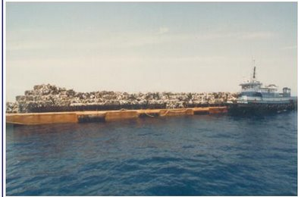
Why do we care about waste and recycling?
Mobro 4000 (1987)

Slide 3
Why do we care about waste and recycling?
Mobro 4000 (1987)
WALL-E (2807)

Slide 4
Waste and recycling in the US
Surge in community recycling programs – from 1,000 to 10,000 from 1990 to 2000
Roughly one-quarter to one-third of municipal solid waste generated is recycled
Over half of all households have curbside recycling access
Deposit/Refund in 13 states
Yet…
Notes:
Yet, both the private and social cost of waste disposal may not be as large as once thought…

Slide 5
Social costs of waste disposal
Social costs of waste disposal are relatively small
Palmer, Sigman, and Walls (1997) - $33/ton of waste
7.5% waste reduction is justified
Kinnaman (2006) - $5-8/ton of waste
Little justification for waste and recycling policies
But what about upstream externalities associated with the production and transportation of goods?
Ex: Environmental groups advocate for increased aluminum recycling on the grounds of energy savings
Notes:
What happens when we use a LCA to include all costs associated with product?
This includes all upstream externalities that may exist in the product’s processing and transportation activities.
For example, recycled aluminum uses only 5% of the energy required for primary aluminum production.
Many Environmentalists argue for increased recycling on these grounds.

Slide 6
Upstream externalities
[P]olicies that deal with upstream environmental externalities at their source -for example, by setting taxes or standards on air or water emissions from a manufacturing process- are likely to be more efficient than solid waste policies which are several steps removed. – Palmer, Sigman and Walls (1997)
[M]unicipal recycling also reduces the demand for raw materials… If the extraction of raw materials generates external costs, then appropriate regulatory measures are necessary within that industry. – Kinnaman (2006)
Notes:
On the other hand, economists advocate dealing with upstream externality directly.
Thus, the First best policy in presence of upstream pollution is one that taxes the source of the pollution directly.
This is more efficient than policy that indirectly addresses the externality, such as using a waste reduction policy.
But…what if policymakers can’t….

Slide 7
Second-best considerations
But what if policymakers can’t (or won’t) impose corrective policies on upstream externalities?
Likely to be the case in the near term for greenhouse gas emissions
Re-evaluate market-based waste and recycling instruments in the presence of upstream GHG emission externalities
Waste and recycling policies exacerbate or relieve unpriced GHG emission externalities
Notes:
Perhaps re-evaluate market-based recycling policies to incorporate upstream externalities.
Thus creating a second best policy prescription plan.

Slide 8
Key questions
How do emissions savings vary across waste and recycling policies?
How does the interaction effect from reduced emissions compare to the primary benefit of reduced disposal?
What are the implications for waste and recycling policy design?
Notes:
Extend a numerical model (created by PSW) to include GHG….

Slide 9
Methodology
Extend Palmer, Sigman and Walls (1997) numerical model to incorporate GHG emissions by material and input source
“Close the loop” between recycling and production inputs (Walls and Palmer 2001)
Simulate costs net of GHG benefits for a given reduction in waste under
Deposit/Refund (tax on consumption, subsidy for recycling)
Advance Disposal Fees (tax on consumption)
Recycling Subsidies (direct subsidy for recycling)
Notes:
Extend a numerical model created by PSW…
Simulate costs net of GHG benefits for given reduction in waste under:

Slide 10
Virgin
Recycled
V
R
Production
E(V,R)
Emissions
Q
Consumption
W
R
Waste
Recycling
Notes:
ECONOMIC framework
Interested in how changes made on the consumption side as a result of policies will impact the emissions profile of the production process.

Slide 11
Mass-balance and emissions PE model
Calibrated to PSW model (prices, elasticities, quantities for paper, glass, aluminum, steel, plastic)
Consumption:
Production:
Notes:
Mass balance and emissions PE model
Kay parameters are these two coefficients
Recreated the PSW model and calibrated to same data to facilitate apples to apples comparison.

Slide 12
EPA LCA data on emissions from virgin/recycled inputs
Includes process and transportation emissions
Both domestic and international sources
Includes cost of transporting curbside material
Data Assumptions
Average values (not marginal)
Assumes average US fuel-mix for CO2 conversion
Benefits calculations use a price of $25 per MTCO2E (1990 dollars)
Coincides with the US Interagency Working Group on Social Cost of Carbon assuming a 2.5% discount rate
Notes:
Did a sensitivity around this 25 number

Slide 13
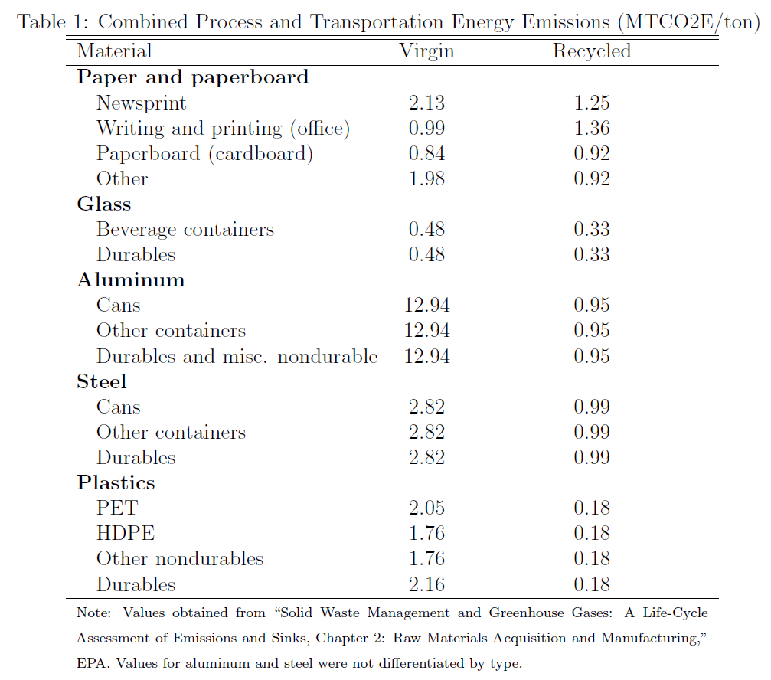
Notes:
Going back to aluminum side, this is the stuff we want and this is the stuff we don’t want. On the other hand, we don’t hear anyone clamoring about glass recycling since it doesn’t provide the magnitude of benefits like we see in other materials.
Interested in how these coefficients impact the emissions generated under each policy.

Slide 14
Channels of emissions reductions
There are two main channels of emissions reductions, exploited to differing degrees by the 3 policies
Source Reduction – By discouraging consumption, less energy is used for production and transportation, decreasing emissions
Increased Recycling – For most materials, an increase in recycling rate results in production from less energy intensive recycled inputs
Notes:
2 main channels of emissions reductions, exploited to differing degrees by policies.

Slide 15
Summary of Results
 | Change in emissions |  | Marginal benefits and costs per ton (10% reduction in total waste)
Policy | Increased Recycling | Source Reduction | Benefits of GHG reduction | Primary cost (PSW, 1997) | Net cost – uniform instrument levels | Net cost – material specific instrument levels
Deposit /Refund | - | - | $26 | $45 | $19 | $17
Advance Disposal Fee | = | - - | $40 | $85 | $45 | $41
Recycling Subsidy | - | + | $10 | $97 | $87 | $81
Notes:
Costs are cut in half when we account for benefits.
The “net cost uniform” represents the net cost of policy under the restriction that instruments are uniform across materials.
In “material specific” case, we find the instrument level for each material that minimizes net policy cost to achieve a 10% overall reduction in waste.
If we allow the instrument level to vary by materials we achieve a 10% saving in cost.

Slide 16
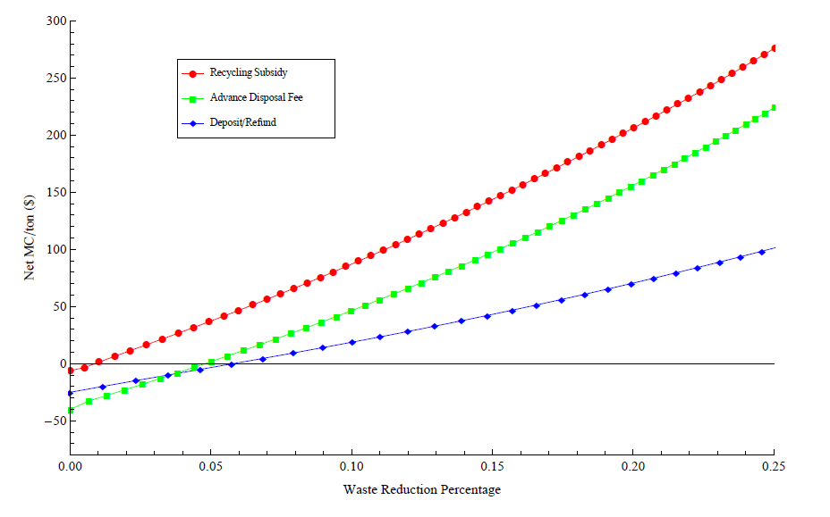
Net cost of waste reduction
Notes:
In absence of any benefits, 5% reduction is justified purely on emissions savings grounds
And now, when we do account for primary benefits…

Slide 17
Net cost and primary benefits
Notes:
This line shows the social cost proposed by PSW of $33 /ton
At this cost of waste disposal, we can justify policy intervention that achieves a 15% reduction in waste.

Slide 18
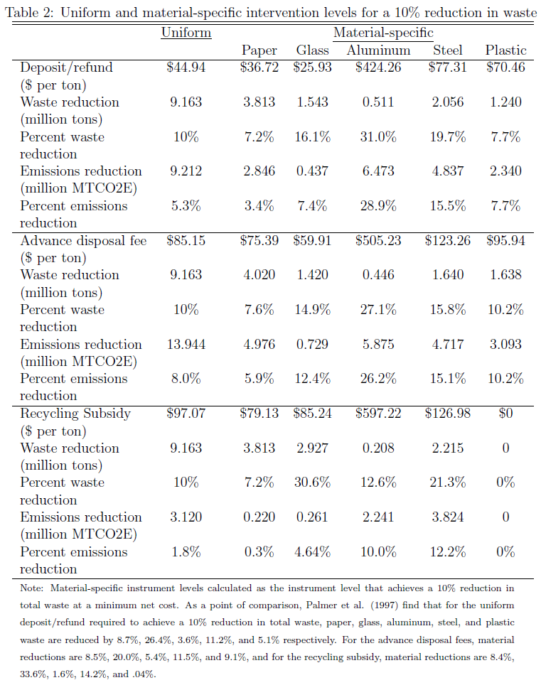
Notes:
Lastly, PSW suggest that a uniform intervention level is the least cost policy. This result is driven by the fact that they assume homogenous benefits of avoided waste disposal (Ton is a ton). By contrast, we have heterogeneous benefits and as a result, we want to increase the instrument level for materials that provide the largest benefit. Set it high to exploit emissions savings.
Examining the case of aluminum, we see a high instrument level, which indicates that a variable policy will go after the materials that offer high energy savings more aggressively than those that offer less savings such as is the case for glass.

Slide 19
Key takeaways
Emissions savings vary substantially by policy
Advance disposal fees generate the most emissions reductions
Recycling subsidies generate the least, despite emissions savings from increased use of recycled materials
GHG interaction effects are large relative to social costs of waste disposal
Larger intervention levels are justified
Deposit/refund is typically the least cost policy
Modest cost-savings from material-specific policies
Notes:
Policymakers who look at the 95% energy savings of recycled aluminum might want to subsidize aluminum recycling, our research suggests that there are better methods to achieving increased recycling.
Material specific instruments exploit the fact that materials have different carbon contents, thus providing differing magnitudes in benefits.

Slide 20
Thank You!
For further questions or copy of the paper:
kacuff@mines.edu

