Slide 1

Is The Best of Both Worlds the Best We Can Hope For?
Juan Marcos Gonzalez
RTI International

Slide 2
Purpose
Common utility framework
  Count data models used in TCM
  Probit models used in dichotomous choice CBM estimations
Raise some questions
  Do we always get the best of SP and RP?
Notes:
2

Slide 3

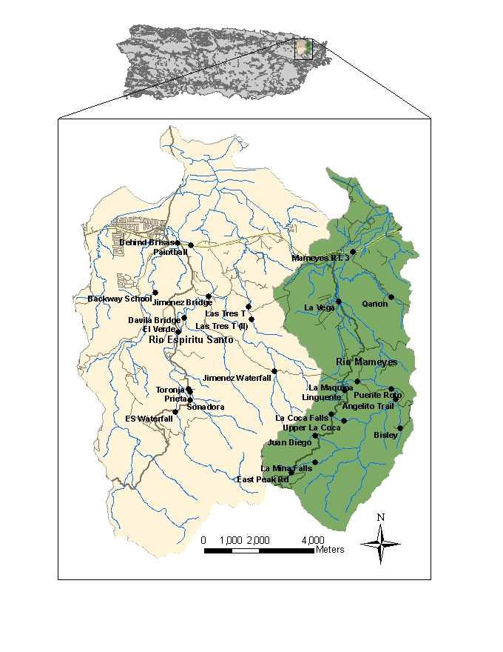
The Empirical Setting
Notes:
3

Slide 4



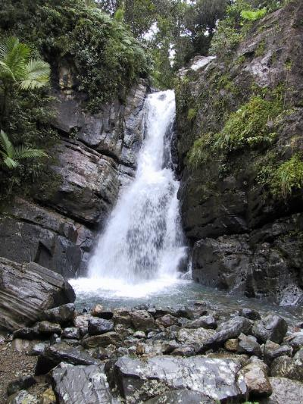
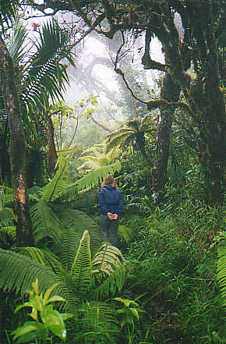

Slide 5
CBM Question
“Taking into consideration that there are other rivers as well as beaches nearby where you could go visit, if the cost of this visit to this river was $____ more than what you have already spent, would you still have come today?”
Bids: $1-$200
Through an increase in gas prices
Notes:
5

Slide 6
Valuation
 | CBM | TCM
Mean WTP | $109.48 | $43.71
  CBM valuation is more than 2 times larger
Notes:
6

Slide 7
Joint Estimation
Estimates from the combined model should result in more efficient parameter estimates as more information on the same set of underlying preferences is employed in constructing the estimates (Larson, 1990)
RP methods “discipline” the SP valuations (Cameron, 1992)
Sizable gains in both bias and precision are found in the simulation experiments -of joint estimation of RP and SP models – (Kling, 1997)
Notes:
7

Slide 8
The Relationship
Utility₁>Utility₀=Yes
Utility₁<Utility₀=No
Utility
(Set of Preferences)
Indirect Utility₁vs.Indirect Utility₀
Optimal # of trips
Notes:
8

Slide 9
The Change in Utility
“Taking into consideration that there are other rivers as well as beaches nearby where you could go visit, if the cost of this visit to this river was $____ more than what you have already spent, would you still have come today?”
Notes:
9

Slide 10
Important Things
At least one trip to the site of interest
Do not alter any of the site characteristics for the dichotomous choice question
Only the marginal price of the last visit is affected by the hypothetical scenario
Notes:
10

Slide 11
The Restrictions
Maximum Utility from accepting price increase
Maximum Utility when rejecting price increase
Income
Seasonal Fee
Site Characteristics
Price of a visit
So we need to look at:
Notes:
11

Slide 12
The Restrictions
If
Then
Notes:
12

Slide 13
Results – WTP

Slide 14
Simulated WTP

Slide 15
Conclusions
Dramatic reduction in the standard errors of the parameters.
  Expected given prior results.
Individual Estimation
  $14.6 millions - $125.6 millions
Joint Estimation
  $57.3 millions - $73.8 millions
Notes:
15

Slide 16
Conclusions
The results show that there is virtually no difference between the two types of surpluses.
Model is generalizable.
…but
Notes:
16

Slide 17
Conclusions
 | CBM | TCM | Joint
Mean WTP | $109.48 | $43.71 | $107.51
Notes:
17

Slide 18
Problem
Gonzalez-Caban and Loomis (1997)
  Population WTP to preserve conditions at sites is approximately $30.
Should we believe results from the joint model?
Is it right to assume that we always obtain the best of both models?
  If not, when not?
Notes:
18

Slide 19
Thoughts
Joint estimation provides weighted average of both models (Azevedo, Herriges and Kling, 2003).
  How are these weights determined?
  Should we incorporate our priors into these weights?
“…it is important to note that these gains were found to occur in the idealized world of the simulation experiments.” (Kling , 1997)
Notes:
19

Slide 20
Thoughts
Nature of SP
  Is asking respondents to focus on particular tasks getting us a better resolution?
  Are SP models providing more information, hence carrying more of the weight?
Notes:
20

Slide 21
Bottom Line
What to do?

Slide 22
Results
Notes:
22

Slide 23
Results
Notes:
23

